Slide 1
History of Pressure Balancing Valves & LEED Accreditation
Course #:122014P
Notes:
The History of Pressure Balancing Valves and LEED Accreditation
AIA Course #: 122014P
Provider #: L114
Approved
Course Title: The History of Pressure Balancing Valves and LEED Accreditation Course Number: 122014P Delivery Name: Symmons Industries, Inc. Curriculum Group Name: AIA Providers Credit Designation: LU Old Approval Status: Pending Admin Approval New Approval Status: Approved

Slide 2
Best Practice
Symmons is an approved AIA provider
The educational section of this presentation will not be used to promote Symmons products or services
Credit for this course is 1 AIA/CES Learning Unit for HSW/SD
This program is registered with the AIA/CES for continuing professional education. As such, it does not include content that may be deemed or construed to be an approval or endorsement by the AIA or of any material of construction or any method or manner of handling, using, distributing, or dealing in any material or product. Questions related to specific materials, methods, and services will be addressed at the conclusion of this presentation.
Notes:
PRESENTERS NOTES & INSTRUCTIONS:
THIS PRESENTATION CANNOT BE ALTERED IN ANY WAY.
You must complete and submit a speaker agreement! This can be found on the portal http://info.symmons.com/doclibrary/presentations.aspx
Do NOT mention Symmons after this slide! The presentation MUST be scripted, and delivered in a GENERIC manner. If a complaint is received it will likely result in our inability to deliver this course in the future.
You can discuss Symmons and our products AFTER this presentation is completed.
This course will provide each design professional with 1 LU (learning unit).
This course will qualify for HSW (health safety & welfare) credits for AIA/CES.
This course should be offered to design professionals at no charge.
It is your responsibility to download, pass out and return the Attendance Sheet (also found on the portal - http://info.symmons.com/doclibrary/presentations.aspx).
It is your responsibility to pass out, collect and return the Course Evaluation Sheet (also found on the portal - http://info.symmons.com/doclibrary/presentations.aspx)
This course will be audited by any member of the AIA at the request of the AIA/CES office. Please try to adhere to the presentation guidelines and stick to the course content.

Slide 3
Agenda
History of Pressure Balancing Valves
Innovation & Safety
Water Conservation
Finishes
Notes:
Learning Objectives
History of PB valves
Innovation & Safety
Water conservation
Types of finishes, and processes used in their creation

Slide 4
History of Pressure Balancing Valves
Problem
Unsafe shower conditions
Drastic water temperature fluctuations
Causes: Fluctuations in water pressure
Toilets
Dishwashers
Sinks
Solution
Design valve which will address pressure fluctuations
Keep temperature constant
Notes:
What problem brought about creation of the Pressure Balancing valve? It was the drastic water temperature fluctuations that would result in unsafe shower conditions.
These drastic water temperature fluctuations were brought about by pressure disturbances caused by toilets, sinks and dishwashers.
To solve this problem a valve would have to be designed that would address pressure fluctuations and keep temperature constant.

Slide 5
History of Pressure Balancing Valves
Pressure Balancing Shower Valve
Designed in 1939 by Paul C. Symmons
Valve provided greater reliability in mixed water applications
Other pressure balancing valves have since been manufactured
ASSE 1016
1996
+/- 3.0 degrees F temperature variation
2005
+/- 3.6 degrees F temperature variation
Notes:
Safetymix pressure balancing valve invented in 1939 by Paul C. Symmons, the valve would mix hot and cold water in a single chamber and use a pressure balancing piston to regulate pressure fluctuations.
Other types of PB valves including PB/Thermostatic valves have since been mfg. and plumbing codes have also been specified because of this invention.

Slide 6
History of Pressure Balancing Valves
Valves are now used in multiple applications
Hospitality
Over 3 million valves installed
Residential
Many states now have standard pressure balancing valves to be installed in new constructions or remodels
Notes:
PB valves are now used in over 3 million Hotel rooms and many states have put standards in place to have PB valves installed in new construction or remodels.

Slide 7
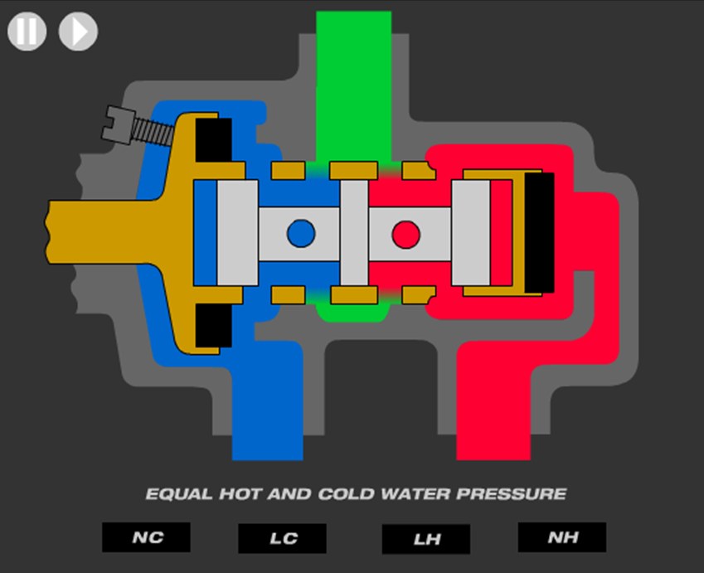
Safety
Pressure Balancing Demonstration

Slide 8
Safety
Temperature regulated within +/- 3 degrees of set temperature
Anti-scald
Shower shock
Limit stop mechanism
Prevents handle from being turned past desired handle position
Useful in applications where Children or Elderly are end users
Low potential for cross over
Notes:
ASSE 1016 standards state that a credited valve must regulate temperature within +/- 3.6F degrees and have a mechanism that will prevent the control handle from being turned past a desired set position.
PB valves with an internal positive shut off have a lower possibility for cross over.

Slide 9
Water Conservation & LEED
LEED
What is LEED?
Why get LEED certified?
Water Efficiency (WE) Credit 3
What is LEED WE Credit 3?
How to get LEED credits for WE 3
Water Reduction Considerations
Benefits of Green Hospitality
Notes:
LEED
What is LEED?
Why get LEED Certified?
Water Efficiency (WE) Credit 3
What is LEED WE Credit 3
How to get LEED credits for WE 3
Water Reduction Considerations
Benefits of Green Hospitality

Slide 10
What is LEED?
LEED, or Leadership in Energy and Environmental Design, is an internationally recognized green building certification system.
Developed by the U.S. Green Building Council (USGBC) in March 2000, LEED provides building owners and operators with a framework for identifying and implementing practical and measurable green building design, construction, operations and maintenance solutions.
Definition taken from www.usgbc.org
Notes:
LEED is an internationally-recognized green building certification system that provides building owners and operators with a guideline of how constructing, operating and maintaining their building can have less of an impact on the environment.

Slide 11
Notes:
U.S. buildings use approximately
40% of the worlds primary energy use
72% electricity
39% carbon dioxide emissions
14% potable water consumption

Slide 12
USGBC and LEED
U.S. Green Building Council (USGBC)
Non-profit, membership organization founded in 1993
Objective
Incorporate environmental considerations into the building process
Developed the Leadership in Energy and Environmental Design (LEED) rating system
Notes:
U.S Green Building council is a non profit organization founded in 1993 that would find ways to reduce the overall environmental impact on commercial and residential buildings.
USGBC created the LEED system.

Slide 13
Why Get LEED Certified?
Lower operating costs and increase asset value
Conserve energy and water
Healthier and safer for occupants
Reduce harmful greenhouse gas emissions
Environmental stewardship and social responsibility
Notes:
For any given project, a builder must use certain prerequisite practices under categories, and receives credit for completing other voluntary provisions. The total number of credits determines whether a project is listed as Certified, Silver, Gold or Platinum.

Slide 14
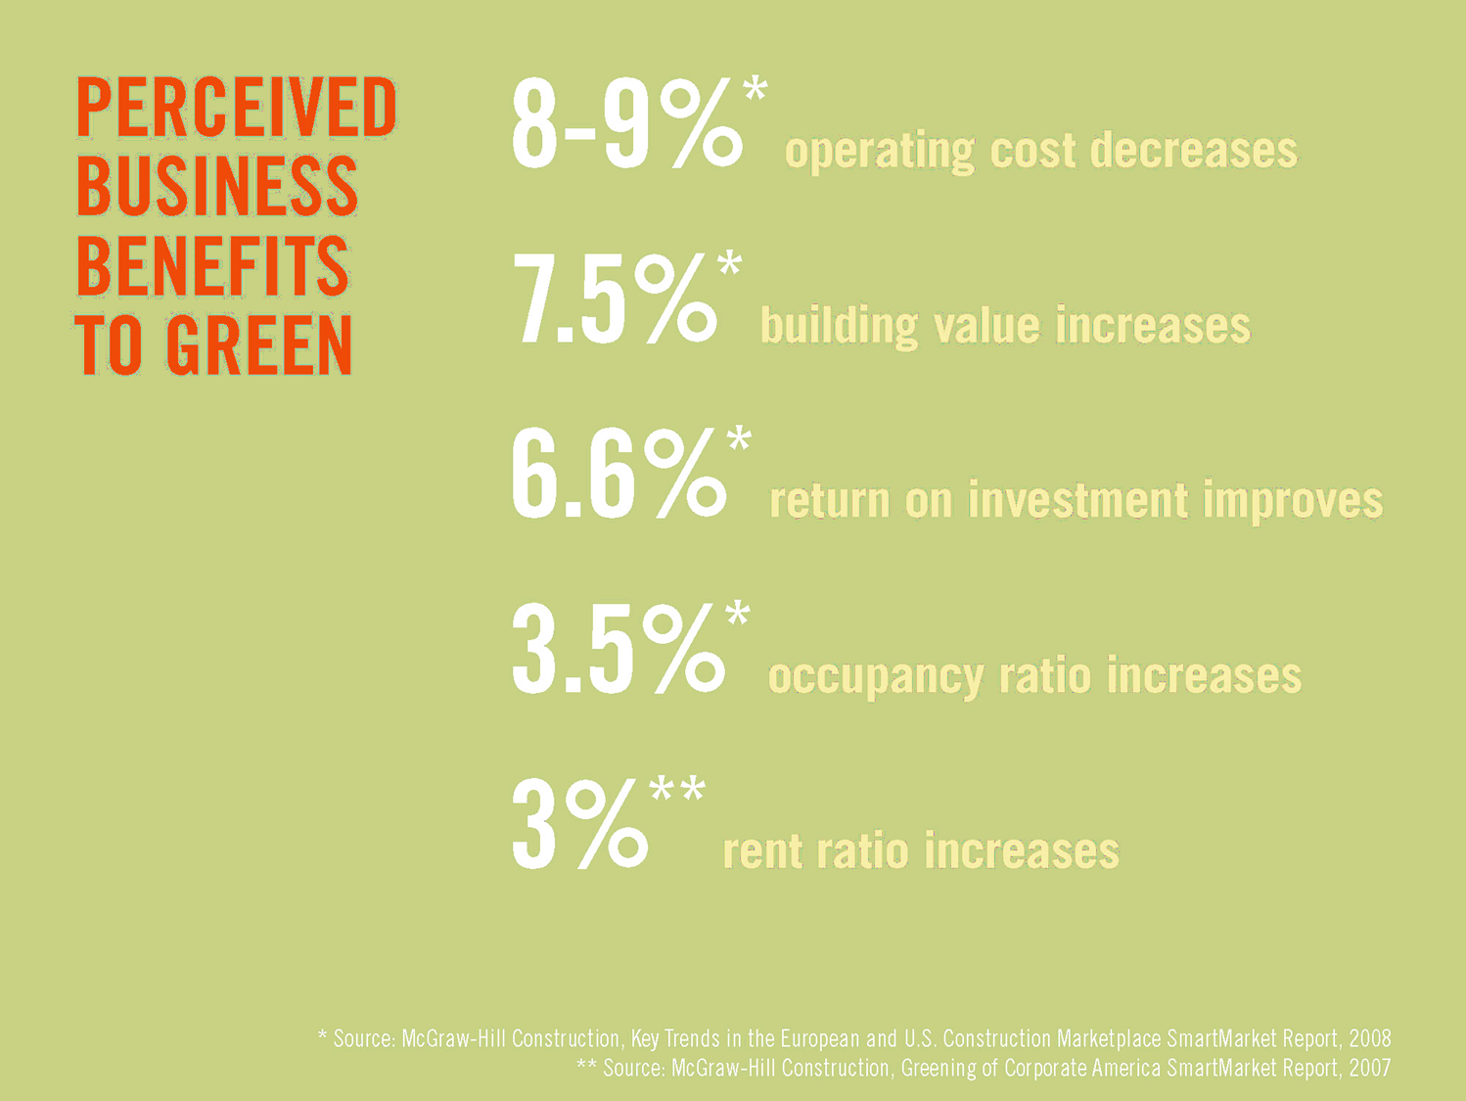
Notes:
Lower operating costs, increased ROI, as well as an increase in the value of the building itself are all ways that businesses can benefit by becoming LEED certified.

Slide 15
LEED WE Credit 3 Requirements
Use 20% less water than the water use baseline calculated for the building (not including irrigation) after meeting the Energy Policy Act of 1992 fixture performance requirements.
Calculations are based on estimated occupant usage and shall include the following fixtures (as applicable to the building): water closets, urinals, lavatory faucets, showers and kitchen sinks.
Definition taken from www.usgbc.org
Notes:
To qualify for LEED WE Credit 3, a building would decrease its water usage 20% from it’ calculated baseline. The water use baseline would be calculated using an occupant usage estimate. The estimate would apply to toilets, urinals, lavatory faucets, showers and kitchen sinks.

Slide 16
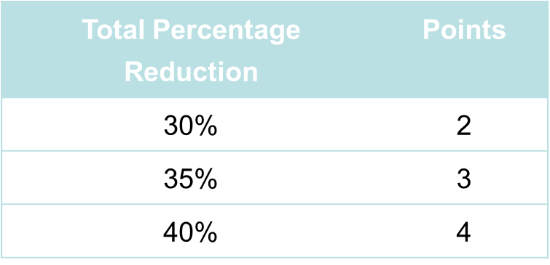
WE Credit 3 – Water Use Reduction
Intent
Increase water efficiency within buildings
Reduce the burden on municipal water supply and wastewater systems
Percent Reduction vs. LEED Points Earned
Lavatory Faucets
Kitchen Faucets
Showers
Toilets
Notes:
The intent of WE Credit 3 was to reduce the amount of water faucets toilets and showers have placed on municipal water supply and sewer systems.
The higher the percentage of water conserved would increase the amount of points a building would be awarded

Slide 17
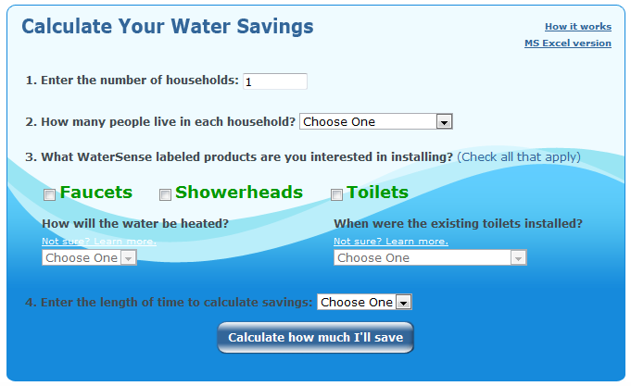
EPA WaterSense Calculator
EPA Watersense Calculator
Notes:
This is an example of the EPA’s water conservation calculator.
Link is active.

Slide 18
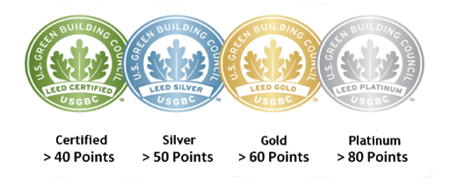
LEED Certification Levels
Notes:
Leed Certified 40-49 points
Silver 50-59 points
Gold 60-69 points
Platinum 80 and above

Slide 19
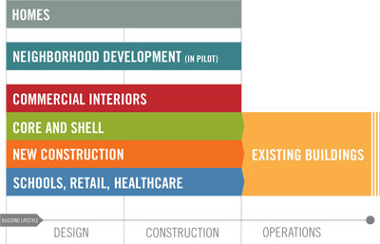
LEED Rating Systems
LEED-NC (New Construction & Renovations)
LEED-EB (Existing Buildings: Operations & Maintenance)
LEED-CI (Commercial Interiors)
LEED-CS (Core & Shell)
LEED-S (Schools)
LEED-H (Homes)
LEED for Retail-NC
LEED for Retail-CI
LEED for HC (Healthcare)
LEED-ND (Neighborhood Development)
Hospitality applications do not have special LEED Ratings
Notes:
The chart shown here shows the types of LEED rating systems and how they are currently applied. For example the LEED life cycle for homes goes through the design and construction phase. LEED life cycle of new commercial buildings, schools, retail buildings and hospitals would go from design, through construction and into operations.
LEED for Hospitality applies to New Construction and Commercial Interiors

Slide 20
Water Reduction Considerations
Changes to supply lines
Changes to inlet piping size
Compensate for PSI
Possibility of Legionnaires’ Disease
Impact of lower volumes of water on waste lines
Potential impacts of reduced flow
Increase shower time
Potential for increased energy consumption
Consumer complaints
Will persons with ailments that can be relieved by the medicinal value of a therapeutic shower be ignored in the name of green?

Slide 21
Valves & Low Flow Showerheads
Concern
Replacing a standard (2.5gpm) with a low flow showerhead (2gpm or lower) to gain LEED Water Efficiency (WE) points could bring about the potential for bathing injuries
Fact
ASSE 1016 standard requires all ATC (automatic temperature compensating) shower valves be designed to work with 2.5gpm showerhead
Issue
No current standard in place for qualifying low flow showerheads with valves
Valve may not be able to accommodate lower flow rate
Safe bathing temperatures may not be maintained

Slide 22
Design Considerations with Low Flow Showerheads
Size and layout of the showering design
Amount of heat being delivered from lower flow head
Droplet size and aeration also impact heat retention
Bather may need to increase the water temperature to compensate
Increase in energy consumption
Possible solutions for problems listed above:
Showerhead placement
Closer to user
Specify height adjustable shower fixture

Slide 23
Benefits of Green
Energy Savings
Reduced Operational Costs
Healthy Guest Environment
Improved Air Quality
Promotes Green Culture in Employees & Guests
Creates Media PR & Outreach
Notes:
Some of the benefits of going green are
Energy Savings
Reduced Operations Costs
Healthy Guest Environment
Improved Air Quality

Slide 24
Example
According to Gary Golla of SERA Architects
The Nines, Starwood branded luxury collection property will be rated LEED Silver for 0.25% cost premium
Will have 30% ROI, 28% savings in energy, water and sewage – for life!
Notes:
Here is an example of how LEED has been used in hospitality and it’s impact.
9 Starwood branded hotels have been rated LEED Silver and a .25% increase to building costs
30% ROI
28% savings in Energy, water and sewerage costs for life

Slide 25
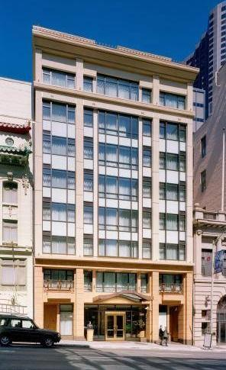
Example
Why Orchard Garden Hotel Chose Green
Occupant Health
Low VOC materials, adhesives, sealants
Improved air quality
Return on Investment
Lower operating costs
Client and Market Demand
Market exposure, site tours, green events, educational value
LEED Certification of the Orchard Garden Hotel
Notes:
Example showing Why the Orchard Garden Hotel chose to go green.
Slide emphasizes points in slide 25

Slide 26
Finishes
Background of finishes
Chrome plating
Need for environmentally friendly finishes
PVD process
Alternate deco finishes
Notes:
This section of the presentation will review finishes

Slide 27
Background of Finishes
Chrome plating
Used for electroplating as early as 1848
Improved process introduced in 1924
Process mostly unchanged since inception
Used for aesthetics and to protect metal
Multiple finishes evolved from original chrome process
PVD
Powder coating
Notes:
Chrome plating has been used as far back as 1848. The process was improved in 1924, but has been mostly unchanged since. In the early phases of chrome plating it was used mainly for aesthetics and to protect metal from corrosion.
PVD and Powder Coating have evolved since

Slide 28
Sustainability & Environmental Impact
Finish needs to adhere to metal
Often requires a build up or multi-step process
Each step involves labor and potentially dangerous chemicals
Final coating is typically inert
Problems
Chemical waste disposal
Environmental hazards
Potential risks to workers
Notes:
Adhering a finish to metal is a multi step process that involves labor and potentially dangerous chemicals.
Waste water disposal has created a potential hazard to the environment.
Chemicals used in the finishing process has also caused a potential risk to workers.

Slide 29
EPA Regulated Plating Facilities
Works in conjunction with EPA on state and federal level
Recycling
Water remediation process
New process incurs higher costs
Eliminated use of cyanide
Less risk to workers
Notes:
Facilities regulated by the EPA work to create less of an environmental impact however these can come at a higher cost.
EPA regulated facilities also eliminate the use of Cyanide that creates a safer environment for workers.

Slide 30
Chrome Plating
Four step process to achieve final product
Strip parts
Copper plating
Nickel/chrome plating
Buffing
Chrome plating represents 97% of the hospitality market choice
Labor intensive: buffing is required to create a mirror surface
EPA heavily regulates facilities that use this process
Cyanide has been used for decades in the process
Waste disposal
Notes:
4 steps of the chrome plating process
Strip, copper plating, Chrome/Nickel plating, and buffing
Chrome finishes are used in 97 % of hospitality applications

Slide 31
Chrome Plating

Slide 32
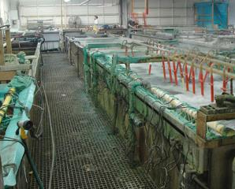
Chrome Plating Process
Electroplating a thin layer of copper flash onto brass
Coating with Nickel
Applying another layer of chrome coat onto the surface
Chrome is an extremely durable finish and is tested to withstand heavy usage
Chrome meets ASME A12.18.1/CSA B125 testing and standards
Carries a standard limited lifetime warranty in consumer/residential applications and a 5 year warranty in industrial/commercial applications
Notes:
Most common finish approach, usually produces a bright chrome finish but can be used to plate other materials, including precious metals such as gold.
There are different processes by which people can electroplate metals such as by mass plating (also barrel plating), rack plating, continuous plating, and line plating. Each process has its own set of procedures which allow for the ideal plating.

Slide 33
PVD Process
Physical Vapor Deposition
Invented by NASA
Faster process
Non-chemical based finish technology
A sealed, highly durable deco finish
Requires less labor
Eliminated water usage
Consistent end result
Notes:
PVD or Physical Vapor Deposition was invented by NASA and is a faser overall finishing process. PVD finishes are highly durable and use less water and labor in the finishing process. PVD finishes have a very consistent end result.

Slide 34
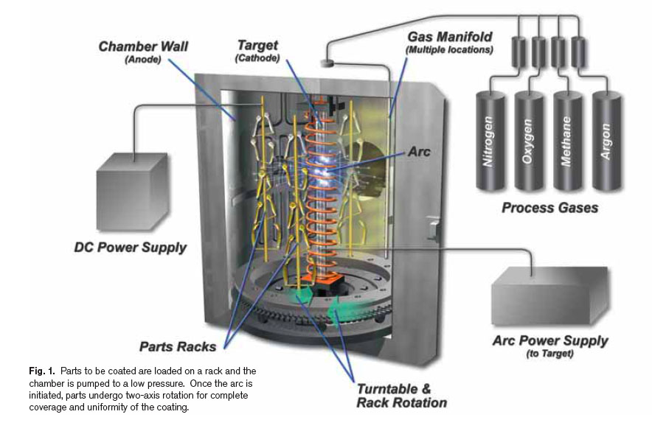
How Does the PVD Process Work
Evaporation
Transport
Reaction
Deposition
PVD Processing Chamber
Source: AZO Materials
http://www.azom.com/article.aspx?ArticleID=1558
Notes:
Here are the 4 stages of the PVD process:
Evaporation
During this stage, a target consisting of the material to be deposited is bombarded by a high energy source such as a beam of electrons or ions. This dislodges atoms from the surface of the target, ‘vaporizing’ them.
Transport
This process simply consists of the movement of ‘vaporized’ atoms from the target to the substrate to be coated and will generally be a straight line affair.
Reaction
In some cases, coatings will consist of metal oxides, nitrides, carbides and other such materials. In these cases, the target will consist of the metal. The atoms of metal will then react with the appropriate gas during the transport stage. For the above examples, the reactive gases may be oxygen, nitrogen and methane. In instances where the coating consists of the target material alone, this step would not be part of the process.
Deposition
This is the process of coating build up on the substrate surface.
Depending on the actual process, some reactions between target materials and the reactive gases may also take place at the substrate surface simultaneously with the deposition process.
The image shown is an example of a PVD chamber:
There are several competing technologies but they all have a few things in common:
Created in a vacuum chamber
Utilizes some sort of target material – most frequently zirconium
The process uses electricity to atomize the target material and re-deposit it on the parts in the chamber
Always a line of site process so racking is critical to complete coverage

Slide 35
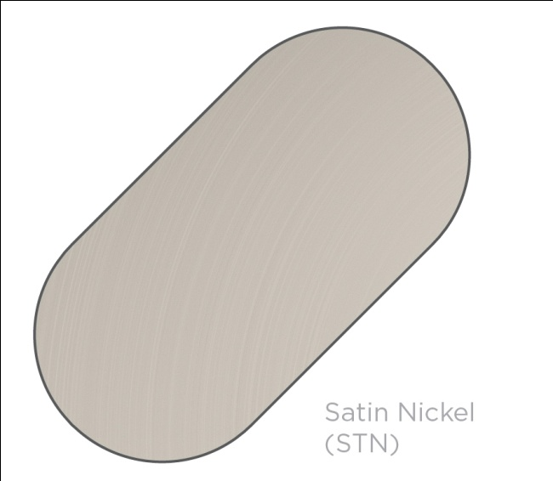
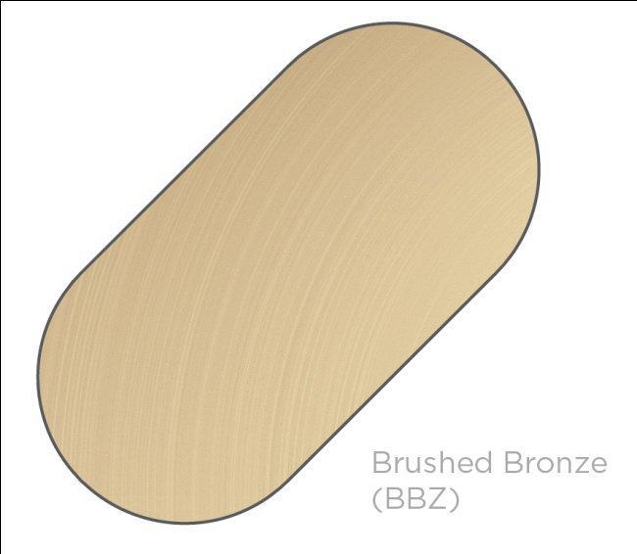
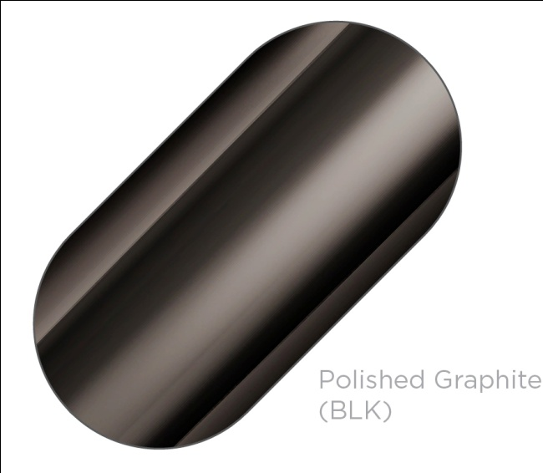
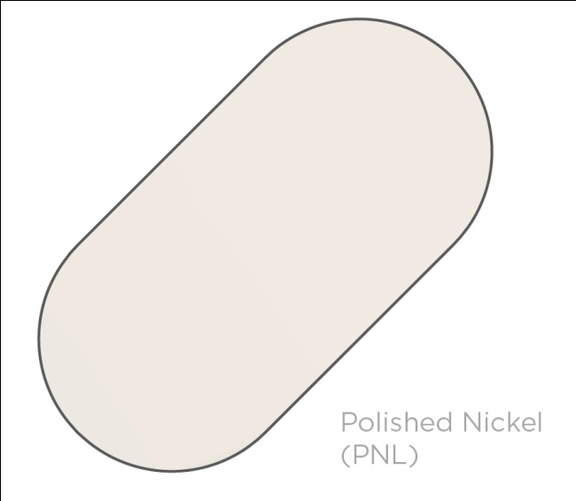
Examples of PVD Finishes

Slide 36
Alternate Deco Finishes
Powder coating
Applicable on both plastic and metal
Infrared used to cure finish
Provides seal over metal
Durability
Consistent color
Colors can be mixed to achieve look of living finishes
Non-living finish unlike other hand applied methods
Notes:
Decorative finishes are now used on both metal and plastic
Strides have been made to make finishes both more durable and consistent
Colors have even been mixed to create finishes such as Oil Rubbed Bronze.

Slide 37
Questions?
Notes:
This ends our AIA presentation for today.
At this time, we will answer any questions you may have, open the floor up to discussion, and provide you with our presentation survey.

Slide 38
References Cited
Kilbane, Timothy. “Water works.” Kitchen and Bath Design: Nov. 2009.
Martin, Shawn. “Do’s and Don’ts of Super Low-Flow Showerheads”. Building Design and Construction: August 2008.
USGBC. www.usgbc.org
"USGBC' and related logo is a trademark owned by the U.S. Green Building Council.“
Golla, Gary. SERA Architects. “LEED Hospitality Properties: Techniques and Costs”.
Lapointe, Melanie. Swinerton Builders. “Orchard Garden Hotel”: July 2006
Aqua Pro Solutions. <www.aquaprosolutions.com>

Slide 39
Thank You

