Slide 1
All About Faucets AIA Presentation
Course #:122014SF
Notes:
All About Faucets
AIA Course #: 122014SF
Provider #: L114
Approved:

Slide 2
Best Practice
Symmons is an approved AIA provider
The educational section of this presentation will not be used to promote Symmons products or services
Credit for this course is 1 AIA/CES Learning Unit for HSW/SD
This program is registered with the AIA/CES for continuing professional education. As such, it does not include content that may be deemed or construed to be an approval or endorsement by the AIA or of any material of construction or any method or manner of handling, using, distributing, or dealing in any material or product. Questions related to specific materials, methods, and services will be addressed at the conclusion of this presentation.
Notes:
PRESENTERS NOTES & INSTRUCTIONS:
THIS PRESENTATION CANNOT BE ALTERED IN ANY WAY.
You must complete and submit a speaker agreement! This can be found on the portal http://info.symmons.com/doclibrary/presentations.aspx
Do NOT mention Symmons after this slide! The presentation MUST be scripted, and delivered in a GENERIC manner. If a complaint is received it will likely result in our inability to deliver this course in the future.
You can discuss Symmons and our products AFTER this presentation is completed.
This course will provide each design professional with 1 LU (learning unit).
This course will qualify for HSW (health safety & welfare) credits for AIA/CES.
This course should be offered to design professionals at no charge.
It is your responsibility to download, pass out and return the Attendance Sheet (also found on the portal - http://info.symmons.com/doclibrary/presentations.aspx).
It is your responsibility to pass out, collect and return the Course Evaluation Sheet (also found on the portal - http://info.symmons.com/doclibrary/presentations.aspx)
This course will be audited by any member of the AIA at the request of the AIA/CES office. Please try to adhere to the presentation guidelines and stick to the course content.

Slide 3
Agenda
Types of Faucets
Styles
Flow Rates
Finishes
Notes:
We will be focusing on faucet and faucet design in today’s presentation.
Our Learning Objectives today are the following:
Types of Faucets: We will cover the types of faucets that are currently offered in the field.
Then go over the flow rate options for faucets, touch upon WaterSense and receiving LEED points.
Then we will move to styles of faucets and explain the difference between them.
Once we review the style, we will move on and briefly discuss the finish options.

Slide 4
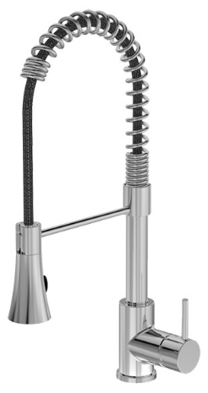
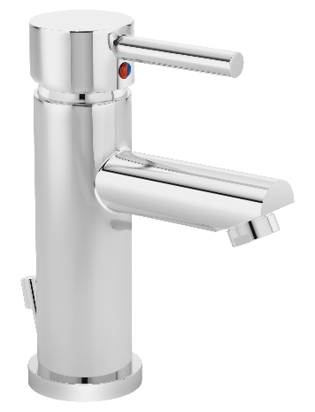
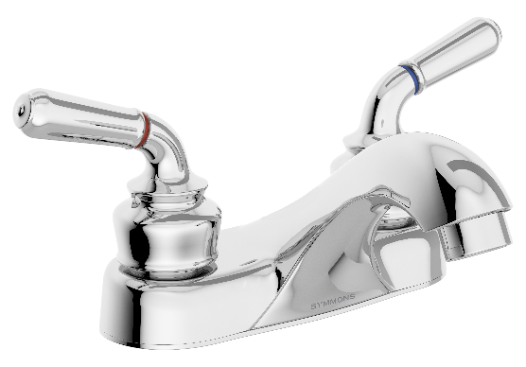
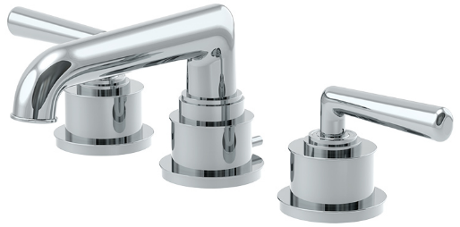
Types of Faucets
Kitchen
Lavatory
Roman Tub
Commercial
Notes:
There are numerous types of faucets but they can all be narrowed down to four generic categories.
The categories are Kitchen, Lavatory, Roman Tub, and Commercial.

Slide 5
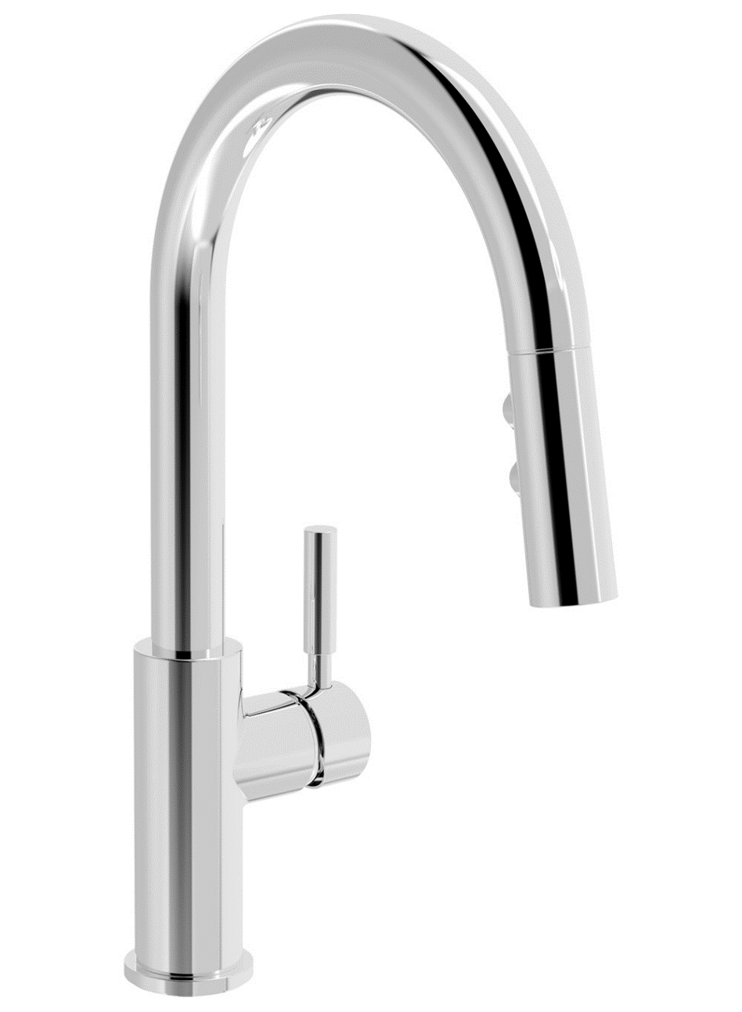
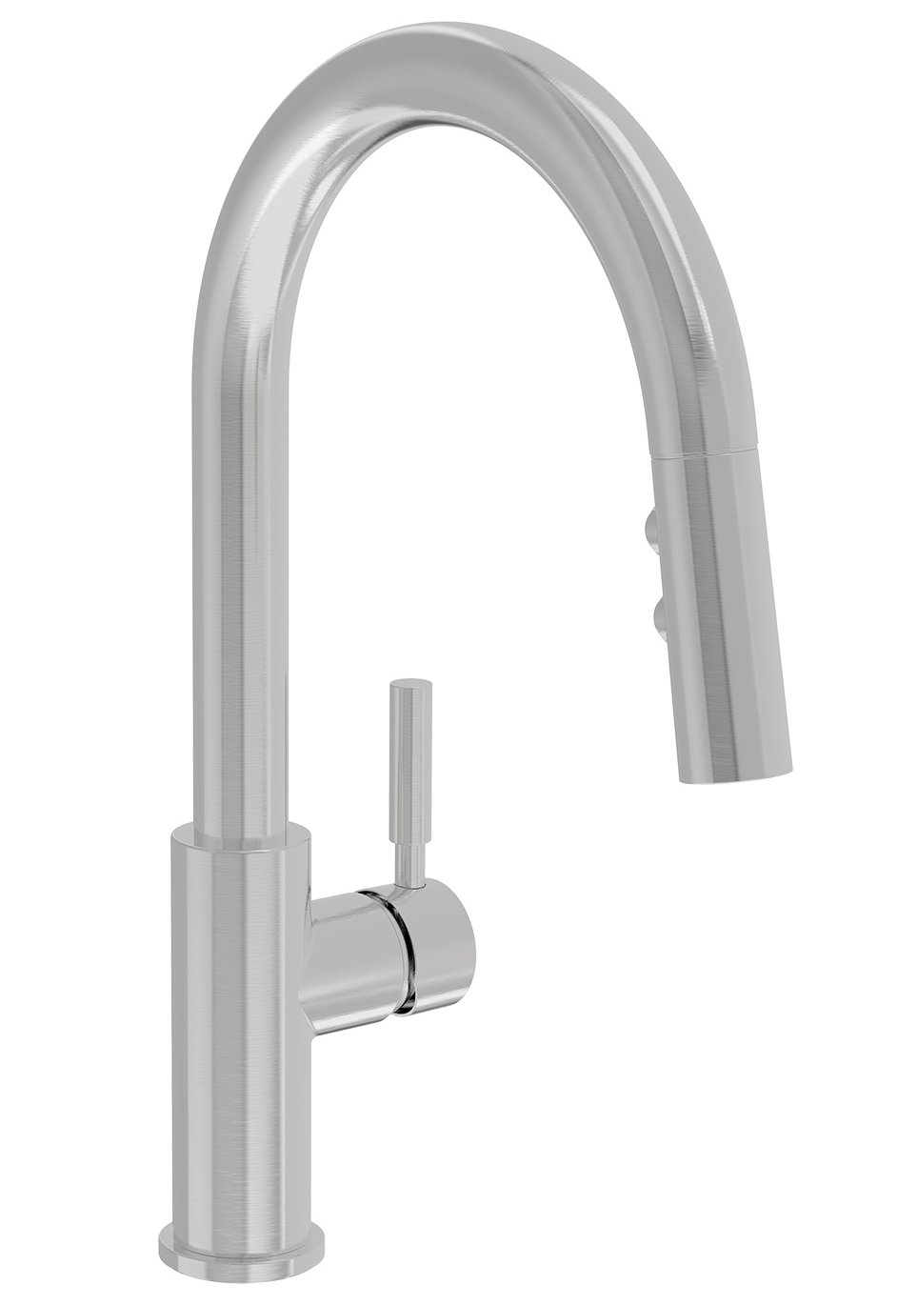
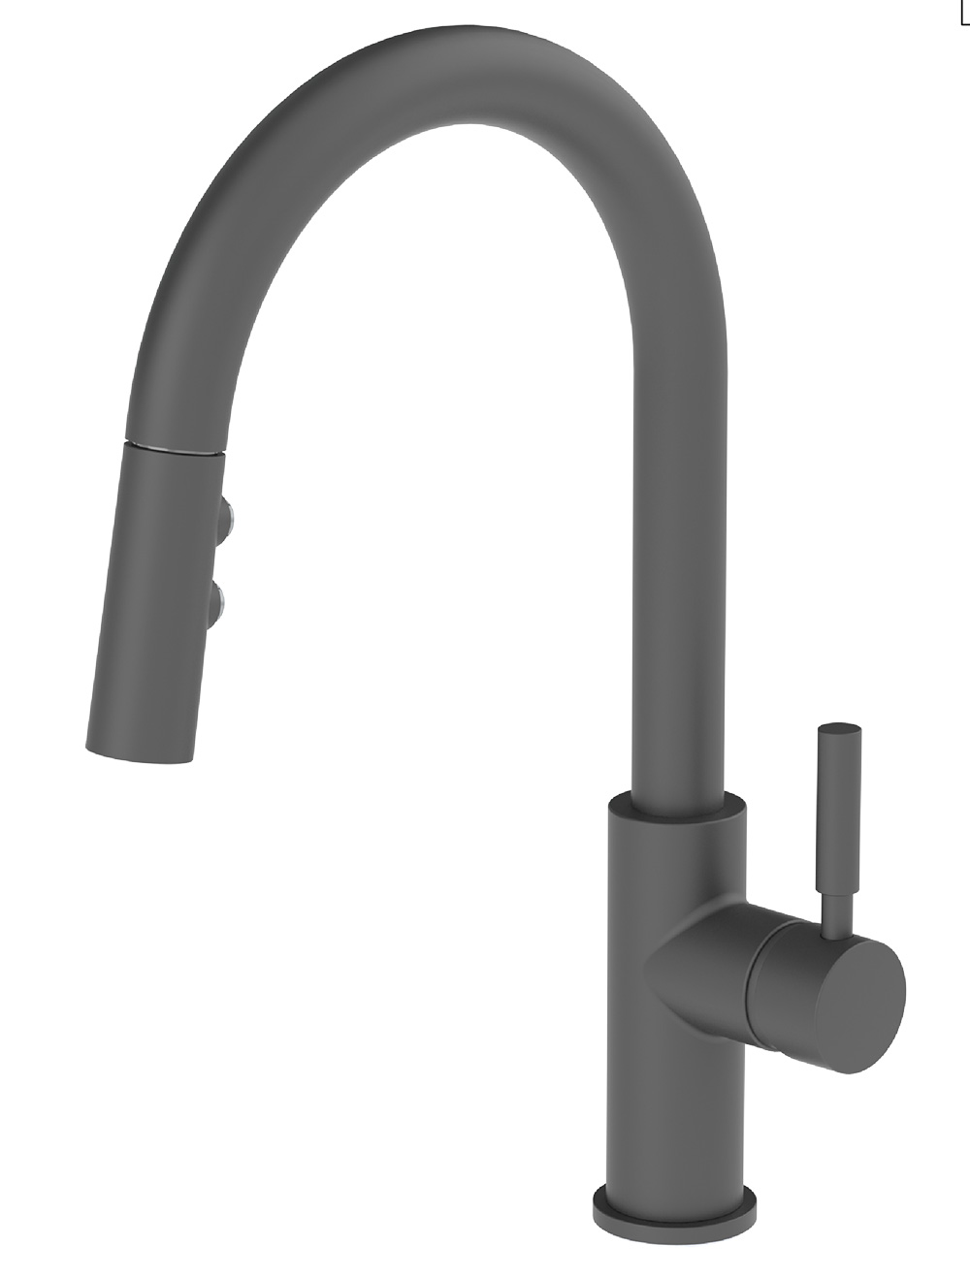
Kitchen Faucets
Notes:
We will start with the Kitchen Faucets.

Slide 6
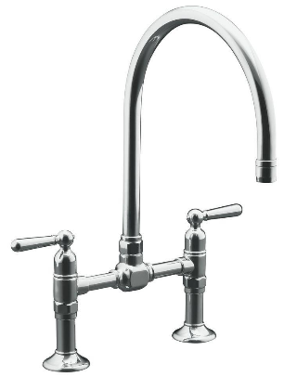
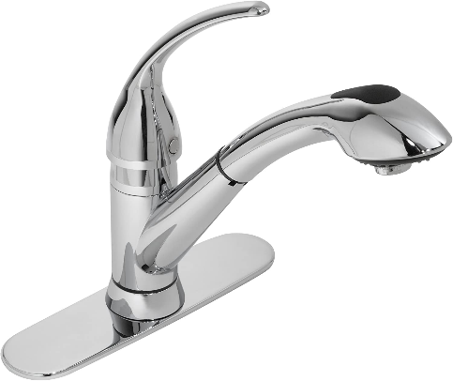
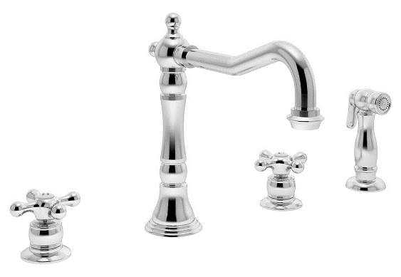
Kitchen Faucets by Sink Type
1 Hole Sink
2 Hole Sink
3 Hole Sink
4 Hole Sink
Single Handle with Deck Plate
Two Handle
One Handle with Two Accessories
Two Handle (Bridge) with Two Accessories
Two Handle with One Accessory
Single Handle with Deck Plate and Accessory
Single Handle with Three Accessories
Single Handle
Single Handle with Deck Plate
Single Handle with Accessory
Two Handle (Bridge)
Notes:
Within the 4 generic categories, we can expand each type of faucet further.
When it comes to kitchen faucets, there are 4 main options.
First option is your 1 Hole Sink
If you have a sink with 1 hole, you can choose between either a single handle faucet or a single handle faucet with a deck plate. The deck plate is usually an add on or modification in order to cover previous damage or cover other holes that were created from a previous faucet.
Then we have your 2 Hole Sink
If you have a sink with 2 holes, you can choose between a single handle faucet with an accessory, such as a hand spray, or you have the option to obtain a more modern look with a two handle bridge faucet.
Moving onto the 3 Hole Sink
When you have a 3 hole sink, your options become more diverse. You can have an option of a single handle with a deck plate, a faucet with two accessories such as a soap dispenser, sprayer or the option of a two handle bridge faucet.
And finishing with the 4 Hole Sink
You can choose any of the configurations with the help of a deck plate and optional accessories.

Slide 7
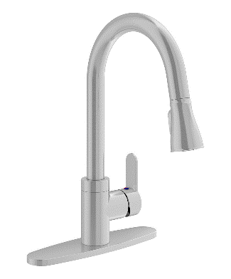
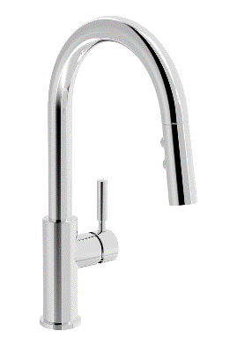
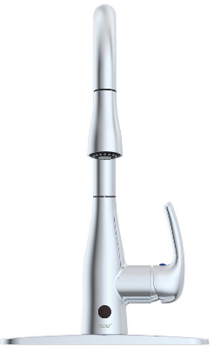
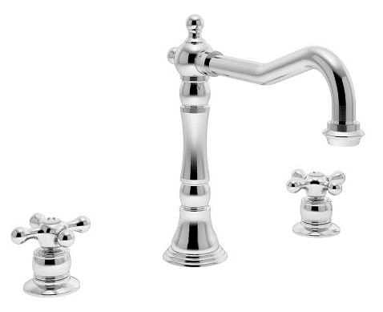
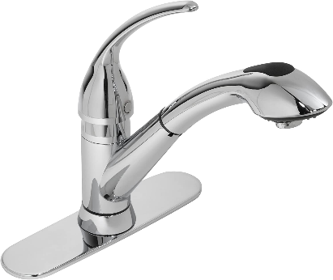
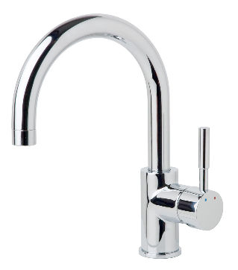
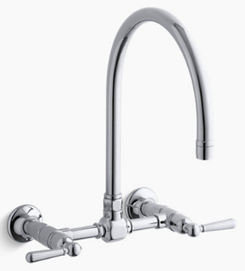
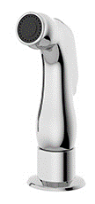
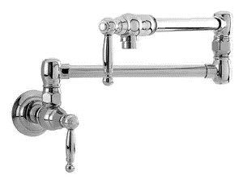
Kitchen Faucets
Single Handle
Two Handle
Pull Down
Pull Out
Sensor
Bar
Wall Mount
Pot Filler
Sprayer
Finishing Touches include:
Fingerprint/
Spot Resistance
Water Filtration
Soap/Lotion Pump
Microban Protection
Notes:
Once you choose your sink type, the kitchen faucet options expand once again.
As shown on this slide, you have the following options:
Single Handle
Two Handle
Pull Down
Pull Out
Sensor
Bar
Wall Mount
Pot Fillers
Accessories - such as a sprayer
There are also numerous options when it comes to your final finishing touches.
For example, you can add a water filtration option to your sink faucet and your accessories can match your lifestyle, such as soap or lotion dispensers. You can also order the faucets in certain finishes that are fingerprint and spot resistant, as well as microban protected.

Slide 8
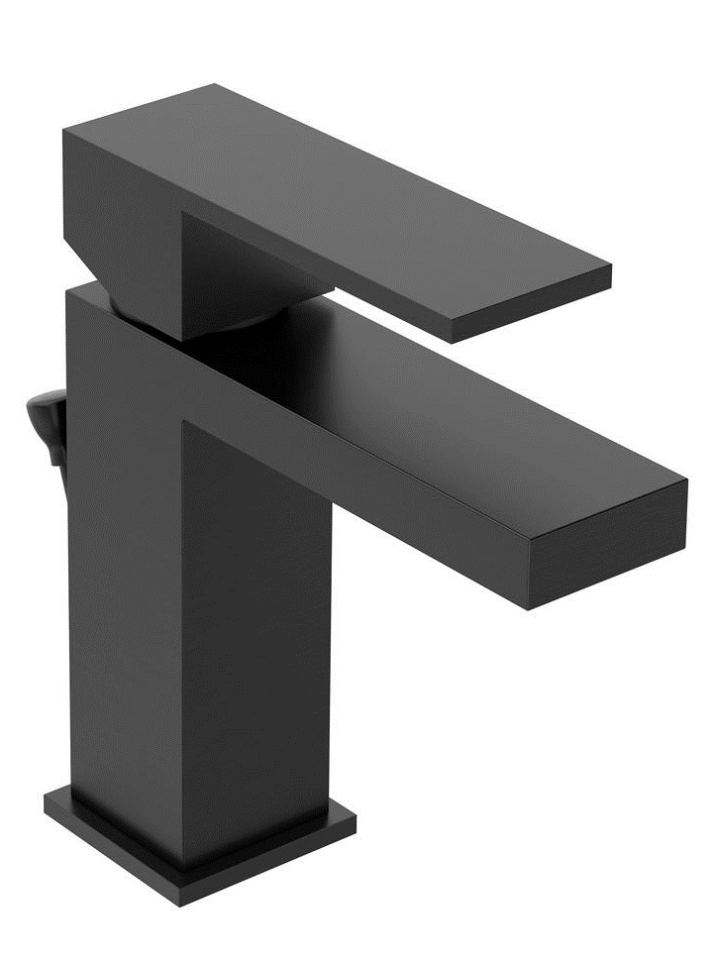
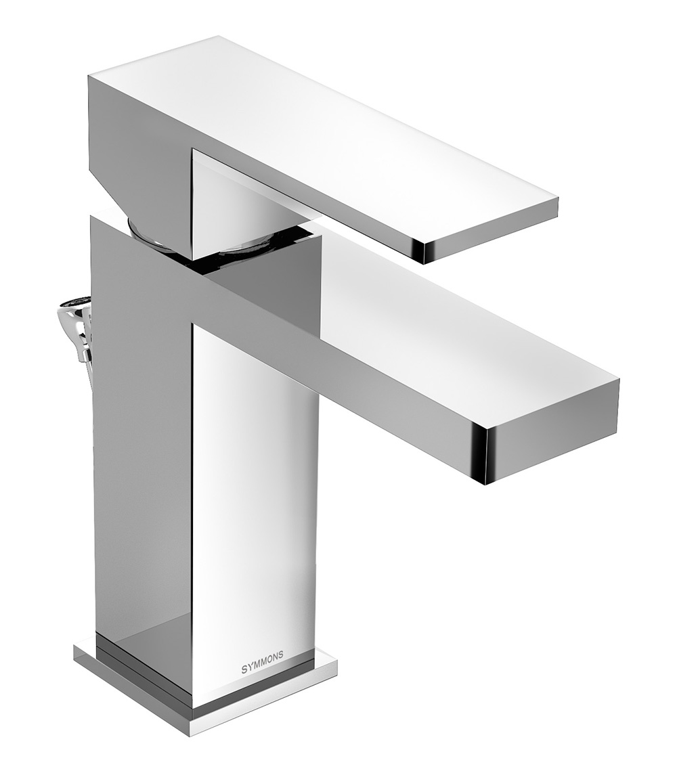
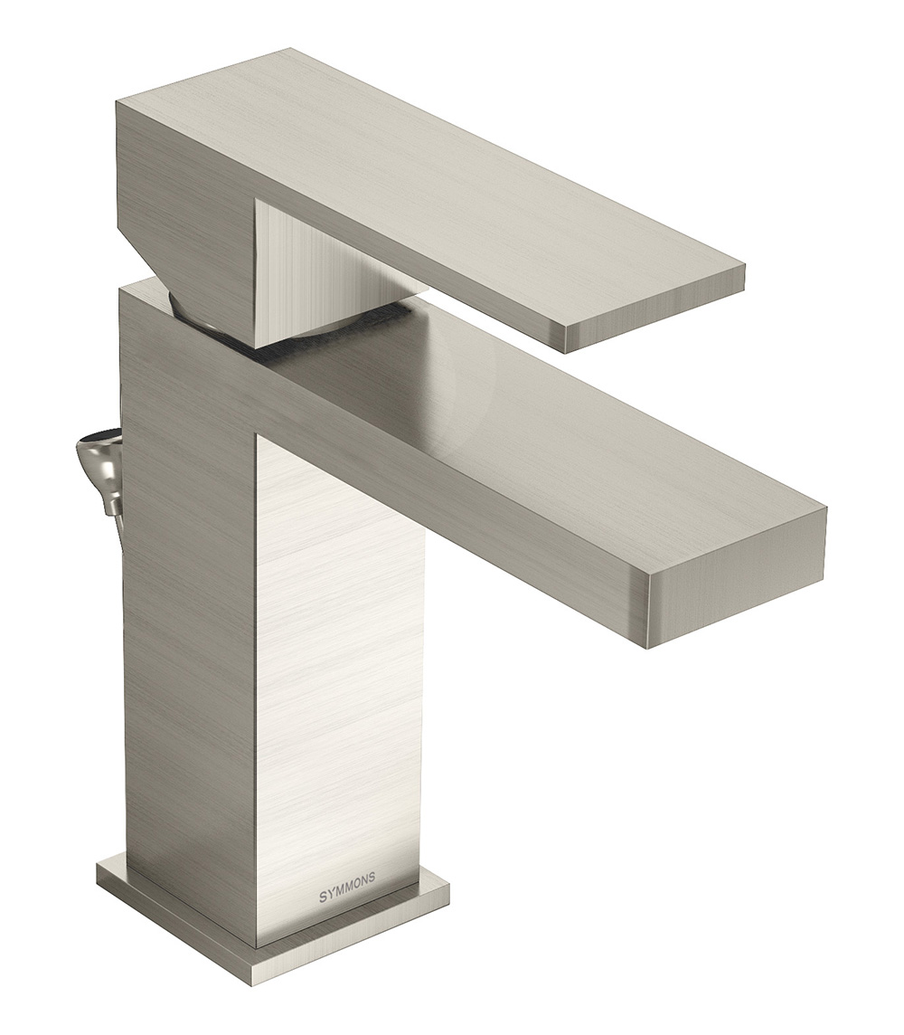
Lav Faucets
Notes:
Now we will move onto discussing lavatory faucets.

Slide 9
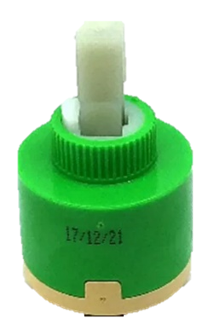
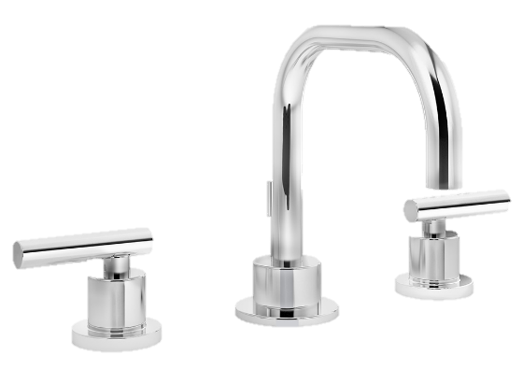
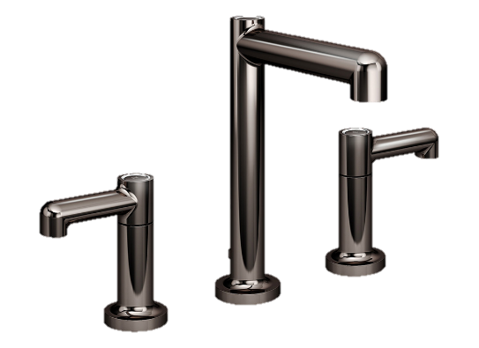
How to Choose a Lav Faucet
Polished Chrome
Polished Brass
Polished Nickel
Satin Nickel
Configuration
Construction/Valve Type
Finish
Style
Single Hole
Centerset
Widespread
Ceramic Disc Valve
Cartridge Valve
Ball Valve
Compression Valve
Chrome
Satin Nickel
Matte Black
Etc…
Contemporary
Transitional
Traditional
Notes:
How to choose a lavatory faucet?
There are numerous things to consider.
Today we will review the top 4 preferences to consider when choosing a proper lavatory faucet.
We will begin with the type of configuration and move onto the construction and valve type. Then we will briefly discuss finish options, as well as style options.

Slide 10
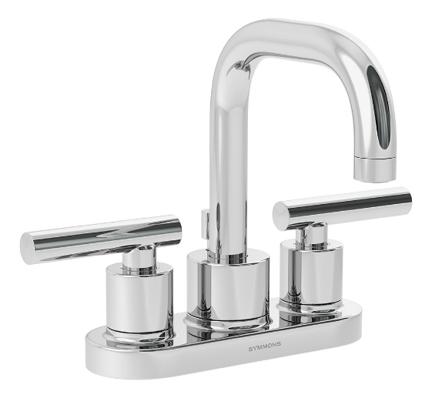
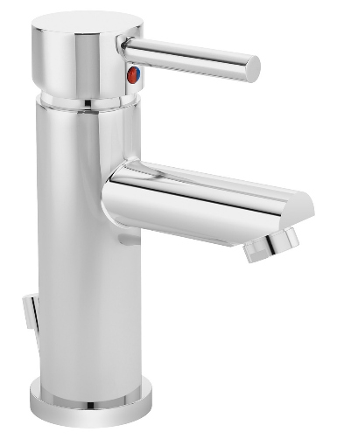
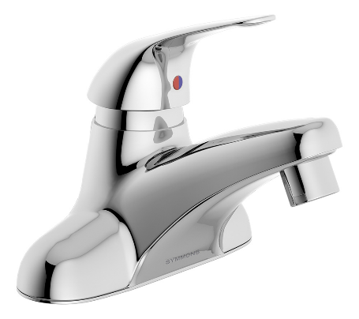
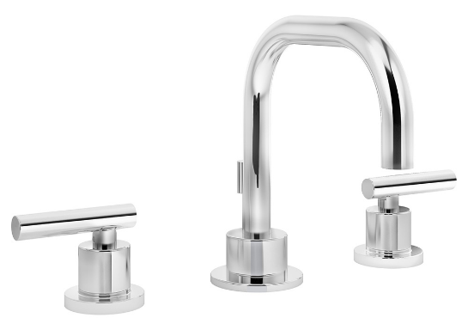
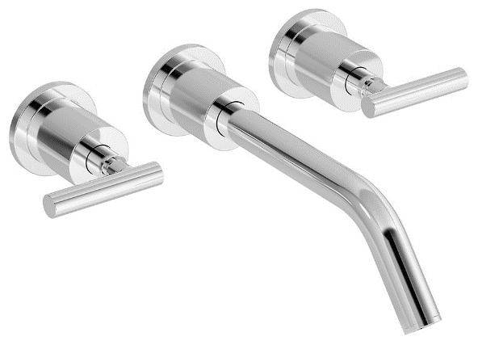
Configurations
Centerset:
Single Handle
Centerset:
Two Handle
Widespread
Single Hole
Wall Mount
Notes:
Configuration:
Configuration is considered how it’s mounted (wall mounted or on the sink), the number of handles it has and how many holes are required to mount it. The two terms that are most commonly used in the industry relating to the faucet’s configuration are centerset and widespread.
These two terms refer to how far apart the holes are in the sink that the faucet will be attached to but also can refer to how far apart those handles are in regards to each other and the spout.
A centerset bathroom faucet is manufactured so the distance between the handles is 4 inches. More often than not, centerset faucets offer the handles and spout together on the base of the unit, creating a configuration that works well in small bathrooms with limited space.
However, if your sink has a 3-hole centerset configuration, you aren’t limited to two-handles. This configuration can also be used by a single handle configuration with the option of a deck plate. When this is the case, the spout and handle are mounted on the deck plate, sometimes called an escutcheon, that is large enough to cover the other two holes in the sink.
Moving on from the centerset configurations, a widespread faucet has a handle for each, the hot and cold water, which are independent of the spout and at least 6” apart.
This configuration is usually preferred for a larger bathroom sink and countertop. It also means you’ll need a 3-hole bathroom sink; two holes for both of the handles and one for the spout.
A faucet which combines the spout and the handle is called a single-hole faucet. There are single lever, two-lever and one-hole faucets. As the name implies, these faucets only require one plumbing access hole in the sink.
Wall mounted units are just as the name implies, they are attached to the wall behind the sink. They work well for vessel sinks that sit on top of a vanity surface.
If you are considering installing a vessel sink and a wall mounted faucet, make sure the spout has the proper height and depth to clear the sink basin, and that the spout is positioned over the drain.
If you only plan on replacing an existing faucet for a quicker and inexpensive renovation without replacing the sink, you will need to be mindful when selecting a configuration that’s compatible with the number of holes already in the sink.
To explain further on what the sizing is when it comes to centersets, widespread, single hole and wall mount we will now list the proper specs that are needed when mounting to the sink.
For a Centerset
It is 4” between handles if separate, or combined together at the base of the unit
3 Holes: Centerset
Single Hole with a 4” deck plate
Widespread
Independent spout and two handles at least 6” apart
Preferred for a larger sink and countertop
3 Hole sink needed
Single Hole
Combines the spout and handle
Single and double lever options
Can be used with a deck plate to cover existing holes
Wall Mounted
Attached to the wall behind the sink
Works well for vessel sinks that sit on top of a vanity surface

Slide 11
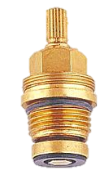
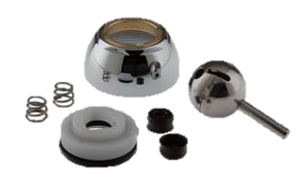
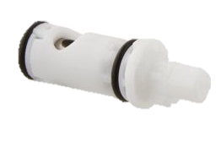
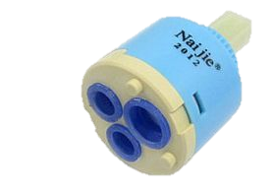
Construction/Valve Type
Compression
Ball
Cartridge
Ceramic Disk
Separate hot & cold handles
Simplest form, flow controlled with screw like feature
Used with single lever faucets
Uses a hollow sleeve attached to the water supply that moves inside another sleeve
Two hard ceramic disks slide relative to each other, controlling water flow
Notes:
Once a configuration has been determined, the overall construction and valve type should be reviewed.
An important feature to consider when choosing a new bathroom faucet, is how a faucet is made and the type of valve it uses.
A faucet that is made well and has good valve technology can provide you with years of reliable service.
The common material used to make the body and spout of a lot of faucets is brass, while other cheaper models are made from lower end plastic.
Brass is normally coated with chrome plating or a PVD finish to guard against spots and corrosion. Without it, brass will tarnish and corrode.
The technology in the valve is what actually controls the flow of water. This would be considered as the brain of the faucet and does all the work, and how it’s designed affects how well it performs.
There are 4 kinds of valve technologies used in bathroom faucets:
Compression
Ball
Cartridge
Ceramic disk
The important point to remember is that the kind of valve that’s used plays a role in its reliability. Reliability equates to how long the faucet works before it starts dripping and needs repair.
Now to go into the details of the valve technologies.
Compression Valve
These valves typically have separate hot and cold water handles. They’re the simplest form of faucet valve and they control the flow of water by means of a screw-like feature in the handle that compresses a seal, which is usually a rubber washer. These valves usually wear out the fastest and need maintenance sooner than other types of valves.
Ball Valves
Ball valves are used with single lever faucets. The ball valve has slots in it that control the mixture and the amount of hot and cold water coming through the spout. When you move the handle, it changes the position of these slots within the valve, regulating the flow. These valves don’t use washers, as in compression valves, but they have more parts, making them more complex.
Cartridge Valves
Cartridge valves use a hollow sleeve attached to the water supply that moves inside another sleeve. The movement of the faucet handle moves the sleeves relative to each other, aligning or blocking holes that control the supply of water. This type of valve has fewer moving parts than a ball valve, however, they do have seals that can wear out and require replacement.
Ceramic Disc Valves
Ceramic disc valves consist of two hard, highly polished ceramic disks that slide relative to each other. The motion between the two disks controls the flow of water by opening or restricting the pathway for the water. Although they’re typically more expensive, ceramic disk valves are considered the most durable and longest-lasting type of faucet valve.

Slide 12
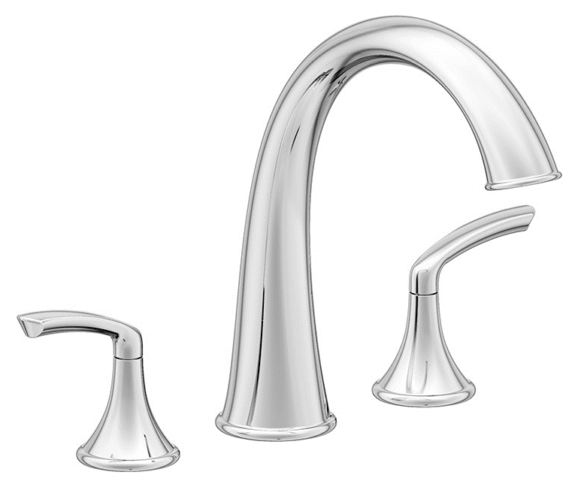
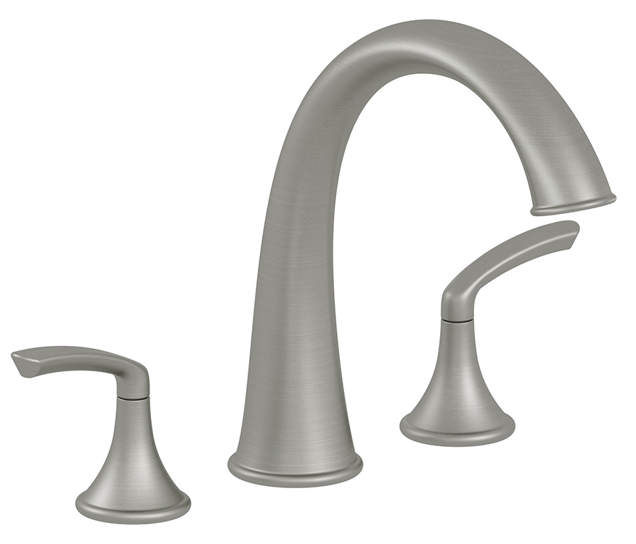
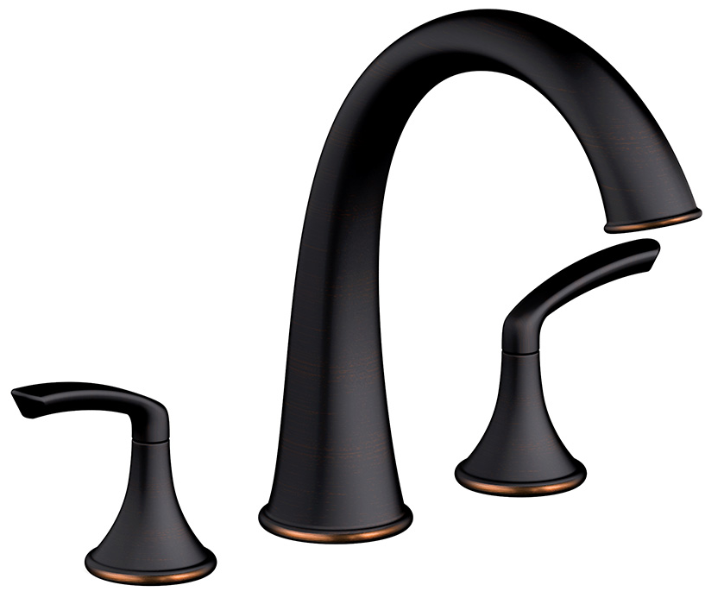
Roman Tub Faucets
Notes:
Now that we have reviewed the steps in choosing a Lavatory Faucet, now we will move onto Roman Tub Faucets.

Slide 13
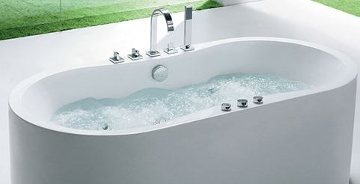
Roman Tub Faucets
Roman Tub Faucets are an elegant option to dress up a bathroom! They are great for standalone tubs which are increasing in popularity.
A Roman Tub Faucet has handles attached to the deck of the tub opposed to the wall or bath. The spout is arched and handles can be single or double and come in a variety of finishes. A handheld shower may be included.
Notes:
Roman Tub faucets can set the look and feel of your bathroom, it can quickly change your bath from a typical tub/shower, to more of a spa like feeling.
Roman Tub faucets are an elegant option to dress up a bathroom. They are the perfect solution for standalone tubs which are increasing in popularity.
The standard Roman Tub faucet has handles attached to the deck of the tub opposed to the wall or bath. The spout is arched and handles can be single or double and a handheld shower can be added as well.
Just like your Kitchen and Lavatory offerings, Roman Tubs comes in a variety of finishes as well.

Slide 14
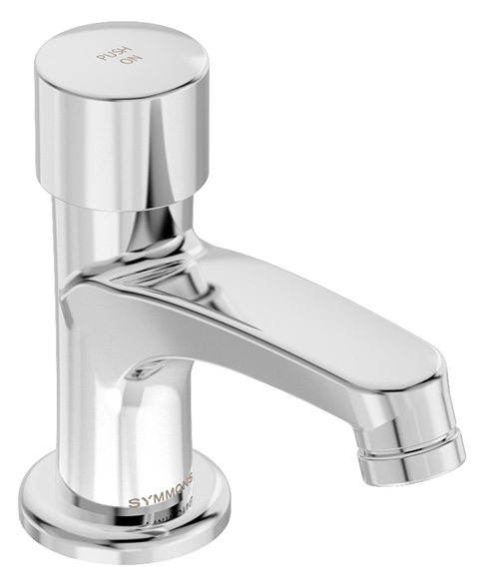
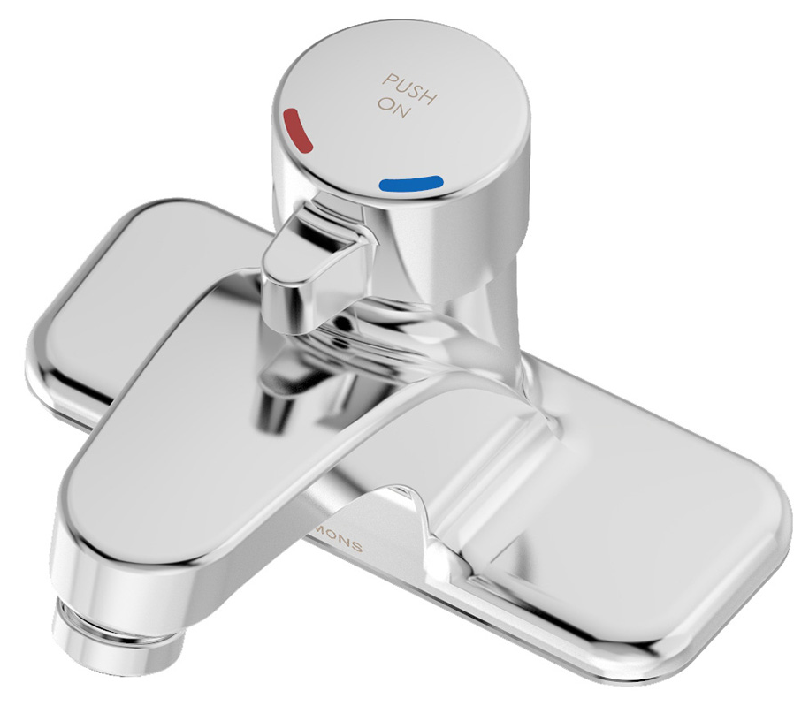
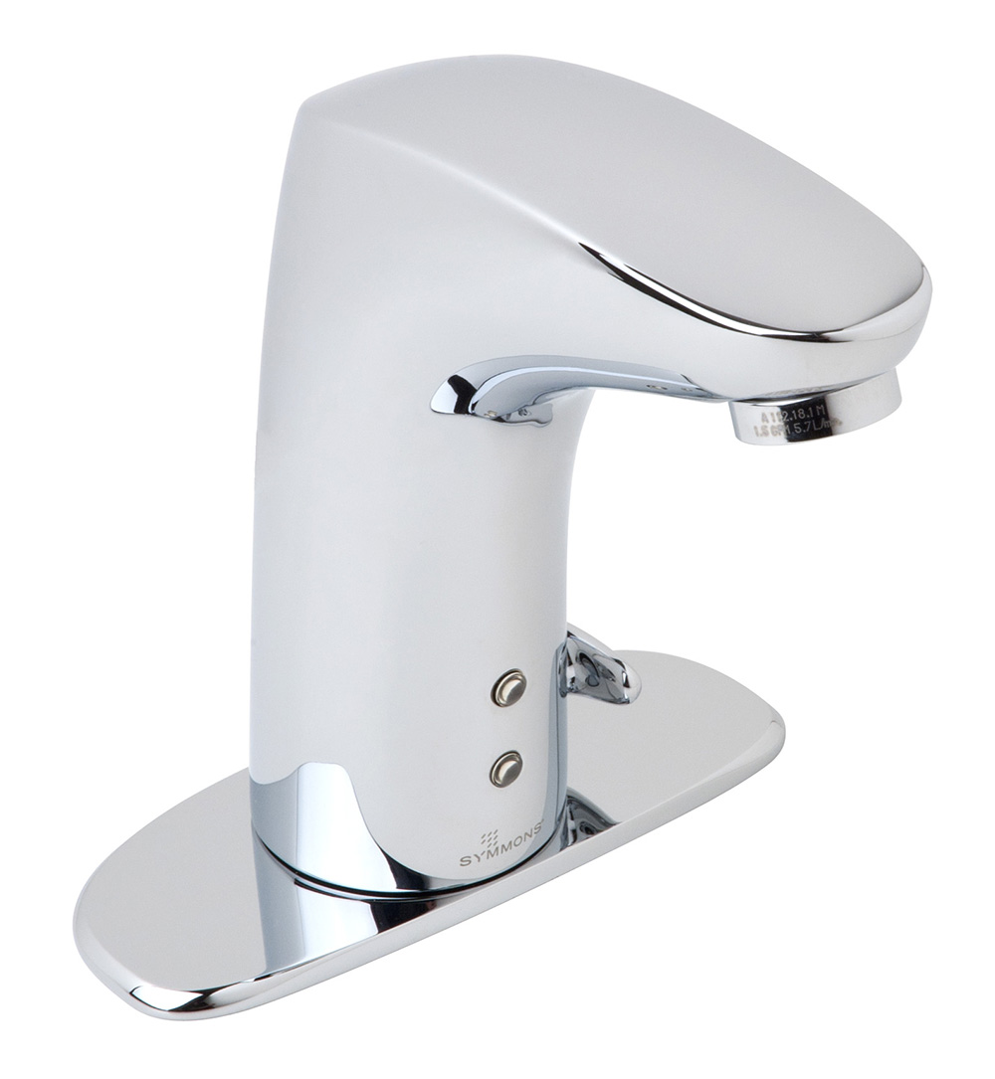
Commercial Faucets
Notes:
Now moving onto the Commercial Faucets.

Slide 15
Commercial Faucets
High quality metal, typically solid brass & copper
High traffic, non-residential settings
Long lasting, built to withstand abuse
Auto shut off options saves water
Notes:
Commercial Faucets are the correct way to go when in a high traffic, non-residential setting. The commercial environment faucets are typically constructed of high quality metal, solid brass and copper. By using the high quality brass the faucets are built to withstand abuse for a long lasting install.
Now in the 21st century, the technology has increased to improve water management, with auto shutoff options and self closing faucets.

Slide 16
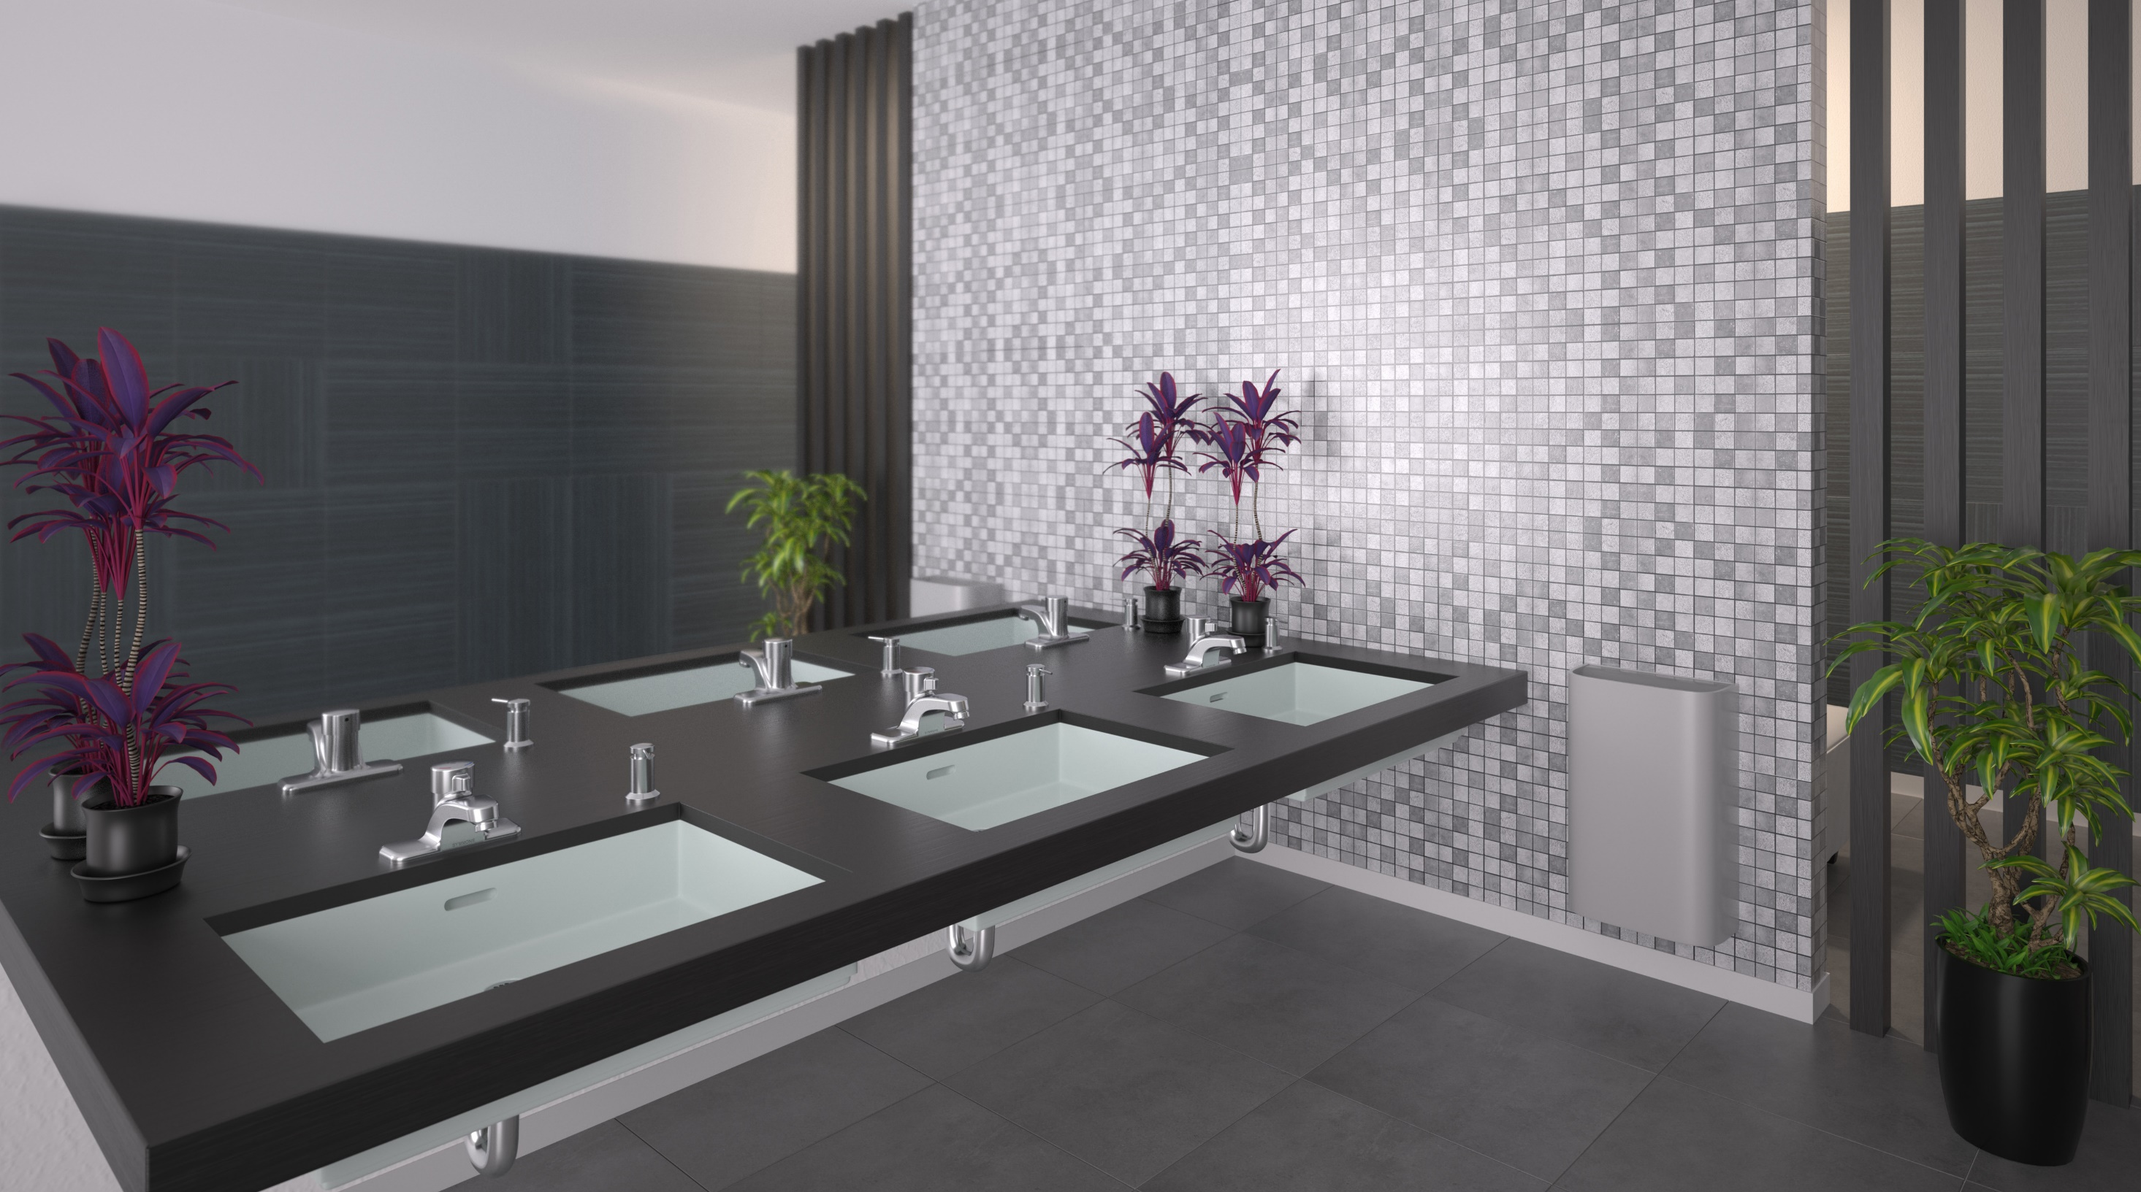
Metering & Self Closing Faucets
Metering Lavatory Faucets
Leg & Foot Activation
End user operates the flow by pressing/ turning handle
Many states require Metering/Sensor faucets in public facilities
Hospitals & places cautious of spreading germs
Adjustable Timer 5-30 sec.
Self Closing
Timing set for too short a time can lead to multiple activations
Flow rate, water pressure & temperature factors in timing
User presses and releases handle/pedal
Water flow stops when handle/pedal is released
Timing determined by needs of end user

Slide 17
Sensor Faucets
Not all have temperature control option & need a separate valve to provide tempered water
Higher cost than a manual use faucet
Updates in technology help prevent false activations
Automatic Control & Low Flow Aerator Options
Possible to decrease lavatory water usage by up to 70% but typically save about 30%
Promotes Hygienic Environment
Eliminates the need to touch handle
Helpful in preventing the spread of disease
Useful for individuals with disabilities
Easy to Operate &
Maintain
Models running on AC power or a sustainable power source are virtually maintenance free
Most Come with Factory Presets
Run from 10 to 30 seconds
Notes:
Run times for sensor faucets are generally preset, however some manufacturers provide the option of varying run time cycles that can be set by the end user.
By opting for a sensor operated faucet, there are many pros and cons.
The cons of the sensor faucets are that they are typically more expensive upfront and not all have temperature control options, resulting in the need for a separate valve to provide tempered water.
There are many more pros when it comes to these types of faucets. First, it promotes a more hygienic environment since it eliminates the need to touch the handle which in turn helps to prevent the spread of disease. It is also a great feature for individuals with disabilities.
The maintenance is typically easier, and there is a possibility to decrease lavatory water usage by up to 70%, but the average savings is about 30%.

Slide 18
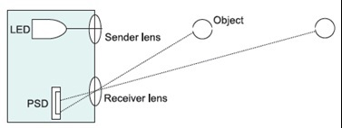
Infrared Sensor Activated Faucets
Most Common Sensor Faucet Activation
Advantages
Disadvantages
Object within range of sensor sends reflection to receiver lens, activating faucet
Technology upgrades help prevent false activations
Hands must be placed directly in front of infrared beam
When object is removed from range, signal sent to stop water
Vandal resistant upgrades prevent unwanted usage
Hands may need to be moved in front of beam for activation
Notes:
Most sensor faucets use infrared sensors to turn water on and off. An example of this is shown in the above picture.
How does this system work?
An infrared beam is sent out by the LED portion of the sensor. A light-emitting diode (LED) is a semiconductor device that emits visible light when an electric current passes through itWhen an object appears and reflects the infrared beam back to the receiver area, the chip in the sensor sends power to the working parts of the faucet causing it to activate. When the object is removed and the infrared beam is no longer reflected to the receiver area the unit will shut off.
Sensor faucets featuring Position Sensitive Detection (PSD) technology are unaffected by inconsistent lighting environments or varying surface colors or textures. They feature an adjustable temperature setting, AC or battery power options, all above deck technology and solid brass housing.

Slide 19
Capacitance Sensor Operated Faucets
Uses Human Body Conductivity
Advantages
Disadvantages
The human body typically has 22-picofarads of capacitance
Ultra low frequency completes circuit needed to activate faucet
Capacitance does not work off of temperature
Sensors typically in spout, approach from any angle to activate
Nonconductive items do not cause faucet to activate
No IR sensor, less risk of vandals damaging sensors
High sensitivity may cause false activations
Placing palm in range of the sensor activates quicker than only a finger
Must be isolated to prevent unpredictable operation
Notes:
Capacitance sensor faucets work similar to an infrared faucet, however, no visible sensor is needed and sensing is done by capacitors located inside of the faucet.
Conductivity of the human body activates components of the faucet and the human body is needed for the circuit to complete the ultra low frequency needed to activate the faucet.
The advantages of offering a Capacitance faucet is that sensors are able to be activated from any angle, and non-conductive items do not cause faucets to activate. There are also zero IR sensors, which creates less of a risk for vandals to damage sensors. IR stands for infrared spectroscopy (IR spectroscopy) is the spectroscopy that deals with the infrared region of the electromagnetic spectrum, that is light with a longer wavelength and lower frequency than visible light.
The disadvantages of the Capacitance faucet is that the high sensitivity may cause false activations, sometimes you will need to place your palm or whole hand in the range of the sensor instead of only a finger. This faucet must be isolated to prevent unpredictable operation as well.

Slide 20
Sensor Operated Faucets: AC Power vs. Battery
AC Power
Battery Operation
Energy needed for activation taken directly from buildings electric supply
Advantages:
Single or multi-unit transformers power 1 - 8 models from a single power source
Lower maintenance, no batteries make these more self-reliant
Disadvantages
Not usable in a power outage
Typical battery life
Infrared faucets ➔ approx. 3 years
Capacitance activated faucets ➔ approx. 5 years
Saves energy by not drawing from electric supply
No hardwiring required
Lower installation costs
Sensor operated devices can be powered by battery or from a building’s electric supply
The amount of maintenance needed for each faucet depends on water quality of the facility & type of faucet
***poor water quality can corrode or clog internal components
Notes:
Currently Battery and AC power are the more common power sources for Sensor faucets.
While battery powered faucets do not draw from the main power supply of the building, they do require a battery be replaced approximately every 3 years, dependent on the number of cycles per day. There are usually lower installation costs, since there is no hardwiring that is required.
AC powered units are generally available with the option of a single plug-in transformer, or a multi-unit transformer that usually powers anywhere from 6-8 faucets at a time. These models require less maintenance than battery, or solar units since they receive constant energy from the buildings power supply. The disadvantages are that these types of faucets are not usable in a power outage.

Slide 21
Metering & Sensor Faucet Benefit Recap
Reduce water, energy and operation / maintenance costs in high traffic areas
Reduction in water & energy costs allow commercial use areas to qualify for credits through programs such as WaterSense & LEED
Promotes a hygienic environment
Advancements in sustainable operating technology provide the opportunity for future water, energy and operational costs
Notes:
For a quick recap on the Metering and Sensor Faucets, you should take away the following.
These types of faucets reduce water, energy, operation and maintenance costs in high traffic areas.
The reduction in water and energy costs allow commercial use areas qualify for credits through programs such as WaterSense and LEED.
The Sensor faucets promote a more hygienic environment and the advancements in sustainable operating technology provide the opportunities for future water, energy and operational costs.

Slide 22
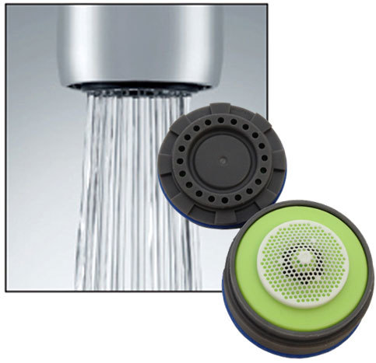
Flow Rates
Notes:
Now we can move onto the different flow rate options that are offered on faucets.

Slide 23
Current Flow Rate Options
Lavatory Faucets
Kitchen Faucets
0.35 GPM
0.5 GPM
1.0 GPM
1.2 GPM
1.5 GPM
1.0 GPM (limited availability)
1.5 GPM
1.8 GPM
2.2 GPM
Notes:
Advances in pressure compensating technologies and other aerator technologies have now allowed flow rates to be reduced to as little as .35 GPM and still continue to work satisfactorily for some applications.
More manufacturers are beginning to add aerated and laminar flow 0.5 GPM lavatories as the lower flow rates are becoming more popular and are being mandated by local municipalities.
Lavatory faucets are offered in 0.35, 0.5, 1.0, 1.2, and 1.5 GPM. While usually the 0.35 and 0.5 GPM versions are often a rose spray pattern.
There are less industry standards regulating kitchen flow given its use is often to fill sinks, pots, pitchers – the national requirement is 2.2 GPM.
Many municipalities and other organizations are requiring or encouraging the use of 1.5 or 1.8 GPM kitchen faucets.

Slide 24
What is WaterSense
Look For
WaterSense
Is a voluntary partnership with the Environmental Protection Agency designed to conserve the water supply. It is a sister program to Energy Star which has been widely publicized.
Certification
To be WaterSense Certified, lavatory faucets cannot flow more than 1.5 GPM at 60 PSI and cannot flow less than 0.8 GPM at only 20 PSI.
Notes:
WaterSense is a program similar to the Energy Star program that you see with the yellow tags on your major appliances, your furnace, hot water heater, etc…
WaterSense is a voluntary compliance program that yields benefits in sustainability but is also performance based and requires minimum performance levels for the sustainable product. They promote water efficiency and enhance the market for water efficient products.
For instance, a lavatory faucet cannot flow more than 1.5 GPM at 60 PSI for WaterSense but it also cannot flow less than .8 GPM at only 20 PSI.
WaterSense will help consumers identify water-efficient products that perform well, save money, and encourage innovation in manufacturing. The WaterSense label will indicate that these products and programs meet water-efficiency and performance criteria.
Overall, WaterSense labeled products will perform well, help save money, and encourage innovation in manufacturing.

Slide 25
Styles
Notes:
Now let’s look at the different style options.

Slide 26
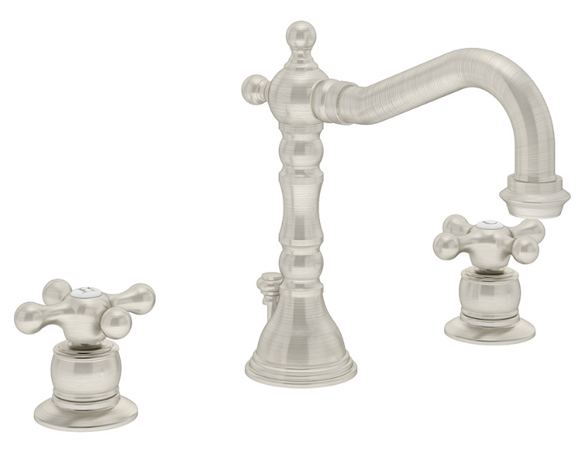
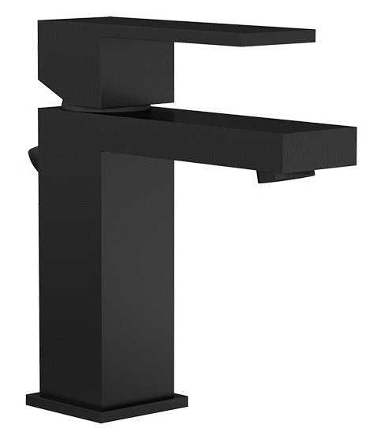
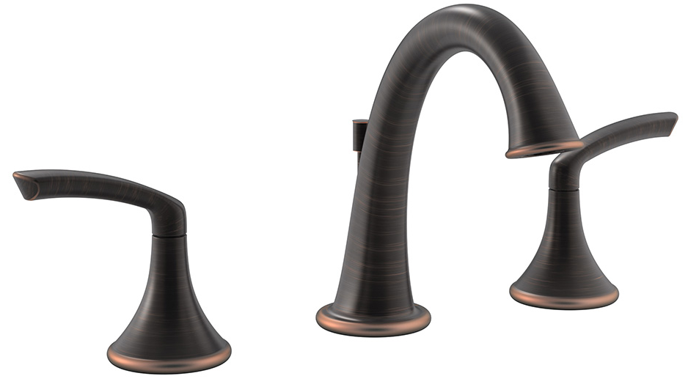
Styles
Transitional
Traditional
Contemporary
Notes:
There are three main styles when it comes to faucets and overall collections.
Transitional
Transitional style is a marriage of traditional and contemporary, equating to a classic, timeless design. Lines are simple yet sophisticated, featuring either straight lines or rounded profiles. It’s midway between old world traditional and the world of chrome and glass contemporary; incorporating lines that are less ornate than traditional designs, but not as severely basic as contemporary lines. Curves combine with straight lines in a transitional style interior to deliver a look that balances both masculine and feminine attributes for a comfortable and relaxing, uncomplicated design.
Traditional
Traditional style reflects a sense of heritage, a respect for the enduring craftsmanship of the past. Ornamentation is selective, balancing fine details and ease of use for a comfortable yet gracious look. Traditional style interiors are comforting and classic and the decorating is calm, orderly, and predictable.
In general, a traditional room will use a mix of vertical lines with more restful horizontal lines. Gentle curves are seen in furniture, pillows, and accessories. Color in a traditional room is often in a mid-range of tones, though very dark and very light colors can also be used. Pretty multi-color floral are often the basis of a traditional color scheme that uses the lightest color on the walls and deeper hues for upholstery and flooring.
Contemporary
Minimalist and streamlined, contemporary style promotes simplicity, harmony and balance. Sculptural elements, often geometric in nature, celebrate the union of man-made items and natural materials.
You might like a contemporary style of decorating if you like to keep current with styles, enjoy things that are modern, of today, right now. While it's been thought that modern interiors are cold and minimalist, today's contemporary interiors are comfortable and welcoming without being cluttered and dark. It's a style that is equally appropriate for offices and stores, lofts and homes. A contemporary style home can be a quiet and comfortable retreat. The palette is often punched up and accented with bright and bold color. Black is often used to ground and define a contemporary style room. In contemporary interiors, less is more. Each piece stands out as individual and unique.

Slide 27
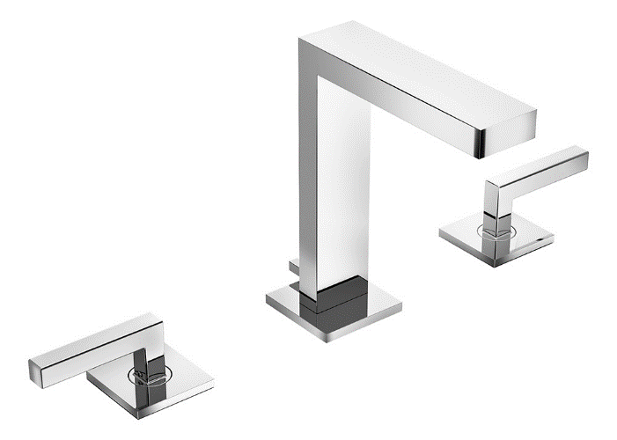
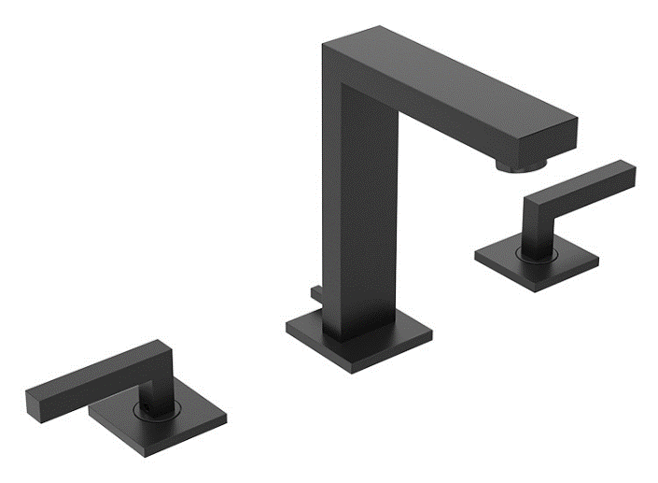
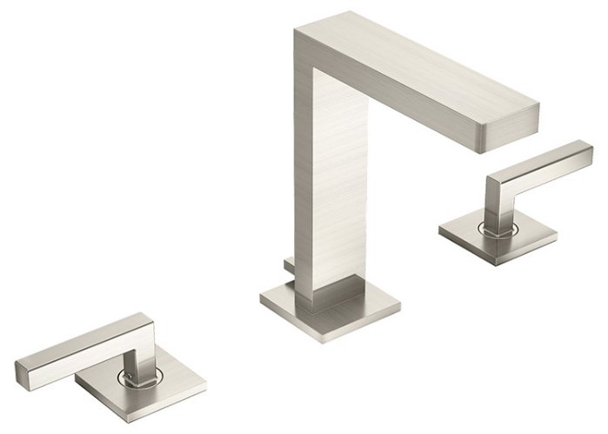
Finishes
Notes:
Finish The finish on a bath faucet is the outer surface treatment that’s applied to all of the exterior parts. The finish gives the faucet its color, as well as, providing protection to its base material.
There is a wide variety of finishes to choose from which may surprise you once you start shopping for a bathroom faucet. You will find the basics like chrome, brass and nickel, as well as, brushed copper, oil rubbed bronze, matte black, satin gold and many more. Besides the look of the faucet, the finish and how it’s applied are important points to learn more about. One of the most durable finishes for a bathroom faucet is a PVD finish. PVD is short for physical vapor deposition, this is the means in which the coating is applied to the surface of the faucet. A PVD surface is very durable and scratch resistant. PVD finishes come in several different colors including stainless steel, brass and nickel to name just a few. Plating is another excellent surface finish treatment. Chrome plating has been a long time standard for faucet plating. Chrome plating is usually applied over faucets made of brass to provide protection to the brass from corrosion and tarnishing. Product finishes also include some which are referred to as a “living finish” and these are usually not covered under a manufacturer’s warranty. Examples include finishes like hand rubbed bronze or oil rubbed bronze. This kind of finish usually doesn’t have any protective sealer and the finish will age and develop a patina (green or brown film caused by oxidation). The moisture in the bathroom, the cleaners you use and even the oils in your hands can affect and change how these finishes look over time, giving them a rustic and aged look.

Slide 28
Finishes
Polished Chrome
Satin Nickel
Stainless Steel
Matte Black
Brushed Bronze
Seasoned Bronze
Champagne Bronze
Vintage Bronze
Polished Brass
Copper
Notes:
Here is a short list of finish options that are possible
Polished Chrome would be your most common, while Stainless Steel is seen more in kitchen applications.
You also have your Satin Nickel, Brushed Bronze, Seasoned Bronze, Polished Brass, Matte Black, Copper and many more.

Slide 29
How Does the PVD Process Work
Evaporation
Transport
Reaction
Deposition
PVD Processing Chamber
Source: AZO Materials
http://www.azom.com/article.aspx?ArticleID=1558
Notes:
Here are the 4 stages of the PVD process:
Evaporation
During this stage, a target consisting of the material to be deposited is bombarded by a high energy source such as a beam of electrons or ions. This dislodges atoms from the surface of the target, ‘vaporizing’ them.
Transport
This process simply consists of the movement of ‘vaporized’ atoms from the target to the substrate to be coated and will generally be a straight line affair.
Reaction
In some cases, coatings will consist of metal oxides, nitrides, carbides and other such materials. In these cases, the target will consist of the metal. The atoms of metal will then react with the appropriate gas during the transport stage. For the above examples, the reactive gases may be oxygen, nitrogen and methane. In instances where the coating consists of the target material alone, this step would not be part of the process.
Deposition
This is the process of coating build up on the substrate surface.
Depending on the actual process, some reactions between target materials and the reactive gases may also take place at the substrate surface simultaneously with the deposition process.
The image shown is an example of a PVD chamber:
There are several competing technologies but they all have a few things in common:
Created in a vacuum chamber
Utilizes some sort of target material – most frequently zirconium
The process uses electricity to atomize the target material and re-deposit it on the parts in the chamber
Always a line of site process so racking is critical to complete coverage

Slide 30
Chrome Plating Process
Represents the majority of product in the market
3 step process to achieve final product
Labor intensive
Buffing required to create a mirror surface
EPA heavily regulates facilities that use this process
Cyanide had been used for decades in the process
Water remediation issues
Labor issues
Waste disposal
Notes:
Chrome is slang for Chromium, one of the 92 naturally occurring chemical elements. Chrome is a metal, but it is not useful as a solid, pure substance. Things are never made of solid chrome. Rather, when you hear that something is chrome, what is really meant is that there is a thin layer of chrome, a plating of chrome, on the object (the bulk of the object usually being steel, but sometimes aluminum, brass, copper, plastic, or stainless steel).
There’s no way to avoid it, the copper, nickel and hexavalent chromium tanks used in the chrome plating process are messy, leading to additional regulatory and permitting requirements for the manufacturer and other remediation issues.
There are two different general applications for chrome plating: "hard chrome plating" (sometimes called 'engineering chrome plating' or 'functional chrome plating') and "nickel chrome plating" (sometimes called 'decorative chrome plating').
Regulations
Electroplating was our nation's very first categorically regulated industry. So what does "categorically regulated" mean? It means that all of the waste products from this industry -- even very dilute rinse water -- are, as a matter of law, regulated because they are from the plating category, even if the particular substance is so diluted that it is harmless or drinkable. Mix the waste in with other waste, and the whole mass is hazardous. A former governor of New Jersey perhaps said it best: "'Toxic' is a matter of statute, not opinion".
In turn this means you can't discharge a drop of hose water without pretreatment and permits; it means you can't take your bad solution anywhere without hazardous waste manifesting; it means you can't accumulate it without permits either. Finally, it means that, because you created the waste, you are legally responsible for it forever regardless of how much you spend to get rid of it.
Cyanide had been used for decades in the process, but the regulations have changed this.

Slide 31
Questions?
Notes:
This ends our AIA presentation for today.
At this time, we will answer any questions you may have, open the floor up to discussion, and provide you with our presentation survey.

Slide 32
References Cited
EPA’s WaterSense
www.epa.gov/watersense
US Green Building Council’s LEED
www.usgbc.org
Neoperl®
www.Neoperl.com
United Nations Educational, Scientific and Cultural Organization
www.unesco.com
US Geological Survey
http://ga.water.usgs.gov/edu/waterdistribution.html
Organisation for Economic Co-operation and Development (OECD)
http://www.oecd.org
US Department of Commerce
http://www.trade.gov/competitiveness/sustainablemanufacturing/index.asp
Alliance for Water Efficiency
http://www.allianceforwaterefficiency.org/uploadedFiles/Resource_Center/Library/non_residential/EBMUD/EBMUD_WaterSmart_Guide_Restrooms_Plumbing.pdf
School Clearing House
http://www.schoolclearinghouse.org/pubs/WaterConservationInformation.pdf
Georgia Dept. of Natural Resources
http://www1.gadnr.org/sustain/toolkit/modules_4_4_2.html

Slide 33
Thank You

